Slide 1
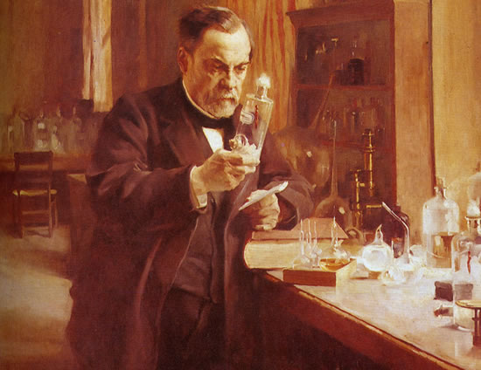
The Nineteenth Century — The Beginnings of Modern Medicine

Slide 2
PLAN.
The Industrial Revolution / inventions.
Public Health.
Chemistry and Pharmacology.
Microscopic Anatomy and Embryology.
Anesthesia.
Education and Licensure

Slide 3
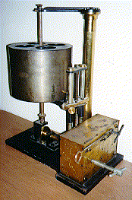
The Industrial Revolution / inventions
There was a general atmosphere of scientific research and advance.
Louis Pasteur's first commission was to find a cure for sour wine, which set him off on his revolutionary course.
Joseph Jackson Lister (Britain: 1826) invented the multi-lens microscope, which allowed doctors to see very tiny things accurately.
Carl Ludwig (Germany: 1847) invented the kymograph, which allowed more accurate measurement of the pulse.
Wilhelm Roentgen (Germany: 1895) discovered x-rays.
Willem Einthoven (Holland: 1900) invented the electrocardiograph(measured heart activity).

Slide 4
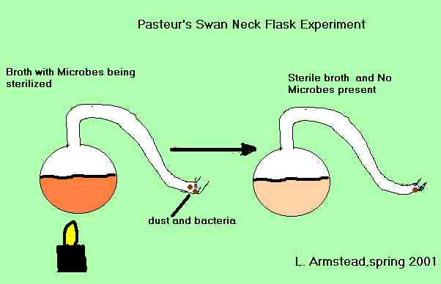
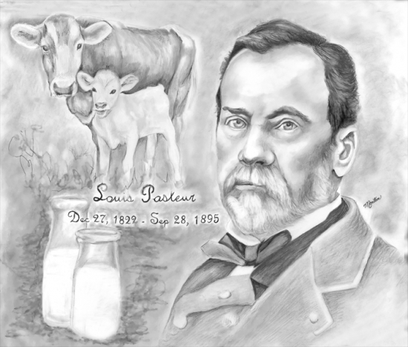
Louis Pasteur (France: 1860s) discovered (by using a swan-necked flask) that germs cause disease. Before he made this discovery, doctors had noticed bacteria, but they believed it was the disease that caused the bacteria (the so-called theory of 'spontaneous generation') rather than the other way round.
One of the spin-offs of Pasteur's discovery was the pasteurisation of milk, which prevented it from going sour by killing the germs and sealing it from the air.

Slide 5
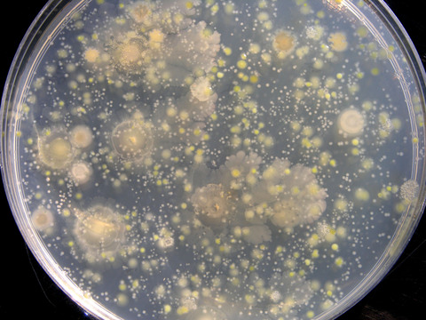
Other scientists also made crucial discoveries, among them:
Robert Koch (Germany: 1878), who discovered how to stain and grow bacteria in a Petri dish (named after his assistant Julius Petri). He was thus able to find which bacteria caused which diseases:
  septicaemia (1878)
  TB (1882)
  cholera (1883).

Slide 6
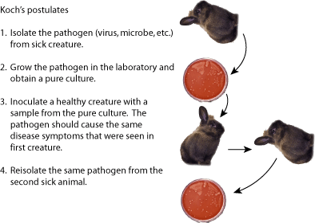
Robert Koch developed his Postulates of how researchers should find a disease. These led to four basic procedures - make sure the germ in question is present in the sick specimen - grow a culture of that germ - inject it into a healthy specimen - see if the disease develops.

Slide 7
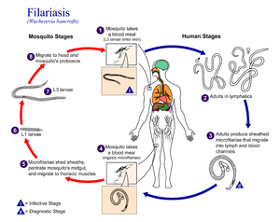
Patrick Manson (Britain: 1876) discovered that elephantiasis was caused by a nematode worm, and that mosquitoes were the vector (carrier). This was a breakthrough discovery, because researchers soon found out that other tropical diseases were transmitted by vectors such as mosquitoes (malaria and yellow fever) or tsetse flies (sleeping sickness).

Slide 8
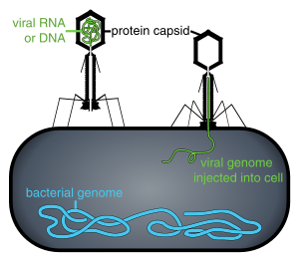
Charles Chamberland
(France: 1884) found that there are organisms even smaller than bacteria that also cause disease - he had discovered viruses.

Slide 9
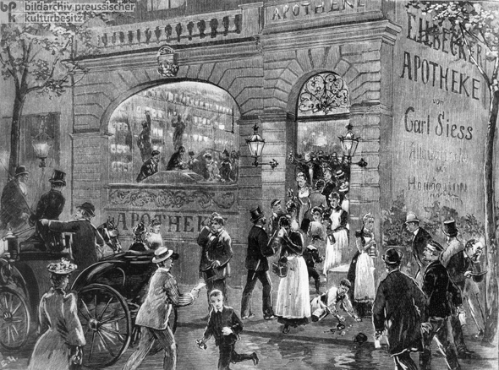
Public Health
The conditions of factory workers, the spread of slums, and the interdependence of communities and nations also affected medical practice.
Notes:
On the other hand, the organization of physicians, hospitals, and public health activities arose out of the nineteenth century itself, owing much to the alterations wrought by the Industrial Revolution. The rapid changes that followed the building of factories and the expansion of cities led to extreme shifts and crowding of populations. The conditions of factory workers, the spread of slums, and the interdependence of communities and nations also affected medical practice.

Slide 10
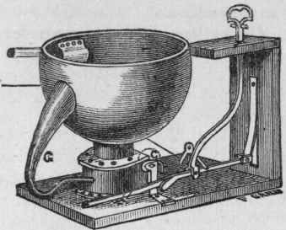
Before the discovery of bacteria as the causes of disease, the principal focus of preventive medicine and public health had been on sanitation
Notes:
Before the discovery of bacteria as the causes of disease, the principal focus of preventive medicine and public health had been on sanitation: the provision of potable water and the dispersal of foul odors from sewage and refuse, which were considered the important factors in causing epidemics. The invention of the water closet by John Harrington (1561-1612) facilitated flushing away human waste and helped to keep some dwellings clean, but the flow from these indoor privies ran into cesspools and ultimately into waterways and wells.

Slide 11
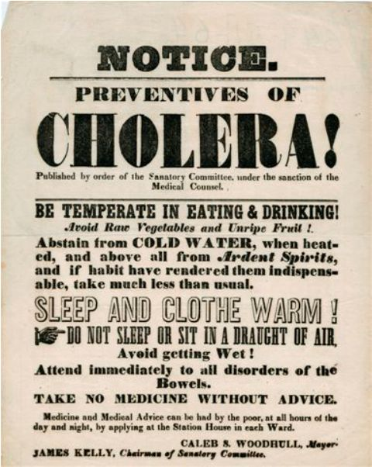
Epidemics continued to devastate cities and countriesPlanned attacks on cholera, typhoid fever, and other pestilences only became feasible after the causes were discovered in the bacteriological era.
Notes:
Epidemics continued to devastate cities and countries. As late as 1854 in London there were 14,000 cases of cholera with 618 deaths. In the United States, cholera ravaged the entire country three times in the nineteenth century. Yellow fever, after striking the northeast from 1793 to 1805, began a series of attacks upon the southern and Gulf of Mexico ports which reached a peak in the 1850s. A sharp decline followed until 1905, when one last explosive outbreak killed over 450 residents in New Orleans. Planned attacks on cholera, typhoid fever, and other pestilences only became feasible after the causes were discovered in the bacteriological era.

Slide 12
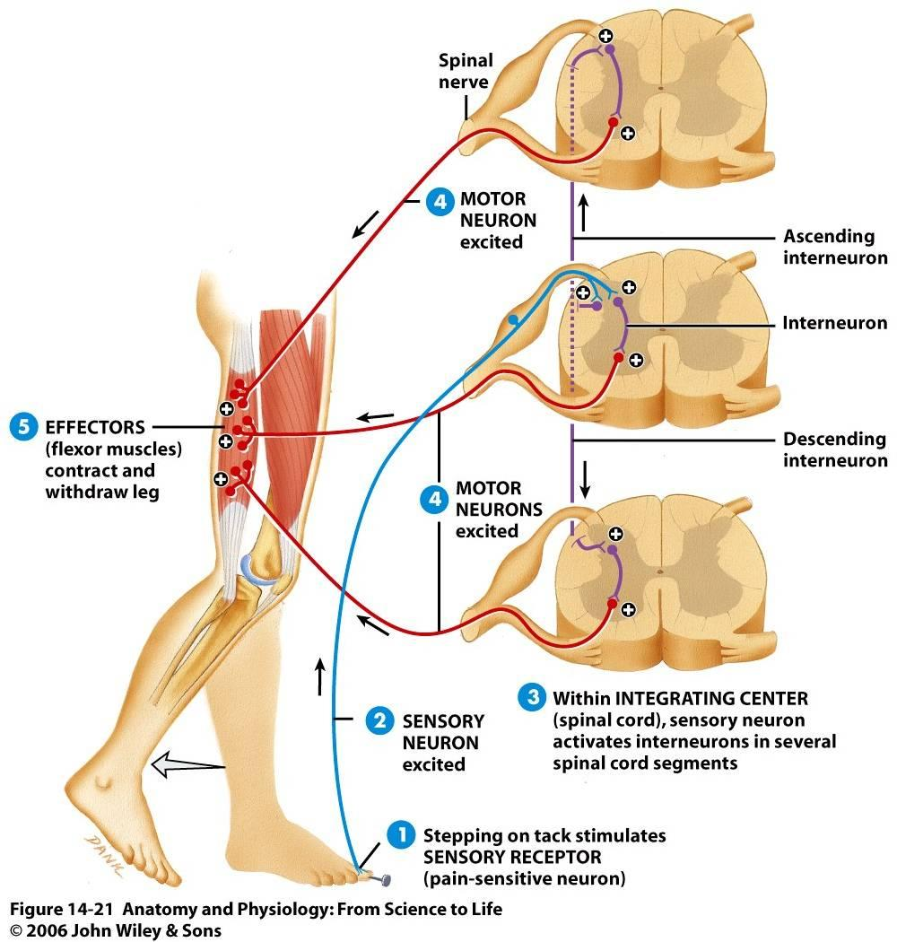
Physiology
"Bell-Magendie
law.”
Notes:
As the century began, France held the lead in medicine. Francois Magendie (1783-1855) was one of the early French leaders who tried to keep his observations simple and free of speculation. He is especially remembered for his experimental proofs that the posterior roots of the spinal canal carry sensory nerve fibers (receiving impulses to the cord) and the anterior roots are motor nerves (transporting impulses away from the cord to the muscles). The priority of this accomplishment was challenged by Charles Bell, among others, and the principle is now called the "Bell-Magendie law." Magendie's analyses of the actions of drugs also made him a founder of the discipline of pharmacology. Never holding an academic position, he was nevertheless a typical investigator of the early nineteenth century in combining the careers of medical practitioner and laboratory experimentalist.

Slide 13
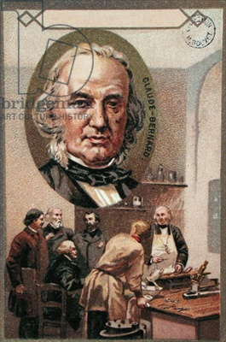
Claude Bernard further developed the precepts of his teacher Magendie, postulating questions that could be answered only through experimental vivisectional techniques, which he perfected into elegant experiments.
Notes:
On the other hand, Claude Bernard (1813-78), the virtual founder of experimental physiology, was entirely a man of the laboratory. He further developed the precepts of his teacher Magendie, postulating questions that could be answered only through experimental vivisectional techniques, which he perfected into elegant experiments. One of his influential concepts was the principle of homeostasis, which stated that the "internal environment" is constant in warm-blooded organisms and that physiological mechanisms resist any external factors which tend to alter this internal state.

Slide 14
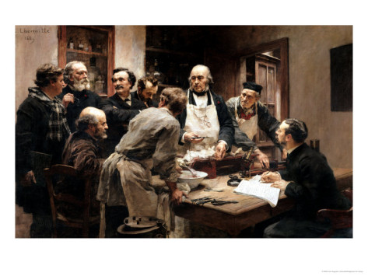
Bernard clarified the multiple functions of the liver, studied the digestive activity of the pancreatic secretions and the association of the pancreas with diabetes, and pointed out the connection of the nervous system with the constriction and dilation of the smaller arteries.
Notes:
Among other exceptional accomplishments, Bernard clarified the multiple functions of the liver, studied the digestive activity of the pancreatic secretions and the association of the pancreas with diabetes, and pointed out the connection of the nervous system with the constriction and dilation of the smaller arteries. In his Introduction to the Study of Experimental Medicine in 1865, he set down the standards for future experimentalists. An imaginative thinker, he had a firm attachment to objectivity, as indicated by his admonition, "Put off your imagination as you take off your overcoat, when you enter the laboratory…"

Slide 15
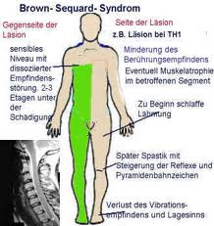
Charles Edouard Brown-Sequard (1817-94) is sometimes considered the founder of endocrinology.
Notes:
Among other exceptional accomplishments, Bernard clarified the multiple functions of the liver, studied the digestive activity of the pancreatic secretions and the association of the pancreas with diabetes, and pointed out the connection of the nervous system with the constriction and dilation of the smaller arteries. In his Introduction to the Study of Experimental Medicine in 1865, he set down the standards for future experimentalists. An imaginative thinker, he had a firm attachment to objectivity, as indicated by his admonition, "Put off your imagination as you take off your overcoat, when you enter the laboratory…"

Slide 16
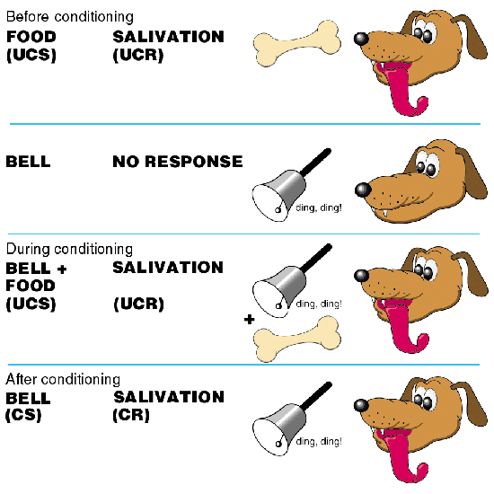
A far-reaching influence on physiology and on subsequent attitudes toward behavior came from the experiments on animals by Ivan Pavlov in Moscow.
Notes:
A far-reaching influence on physiology and on subsequent attitudes toward behavior came from the experiments on animals by Ivan Pavlov in Moscow. After having studied in the laboratories of Ludwig and Heidenhain, he became professor of pharmacology and then of physiology at the Military Medical Academy in Russia. He made detailed investigations on the heart, liver, pancreas, and alimentary tract, but his most influential work was on the conditioned reflex. For instance, he showed that one could condition a dog to salivate and its stomach to secrete in response to an outside stimulus even in the absence of food, by repeatedly linking the stimulus to the providing of food.

Slide 17
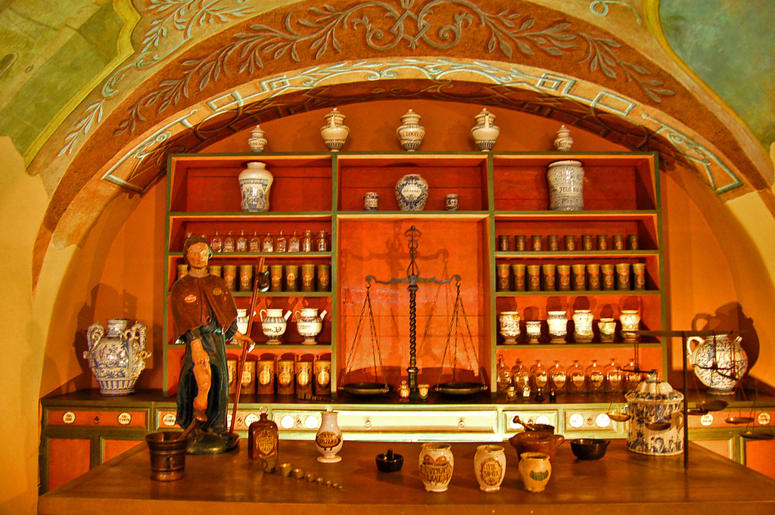
Chemistry and Pharmacology
By the middle of the nineteenth century, examinations of blood and urine were routine.
Notes:
Just as correlations were made between bedside findings and changes in the organs, so too was the chemistry laboratory brought to bear on understanding the functional alterations caused by disease. By the middle of the nineteenth century, examinations of blood and urine were routine

Slide 18
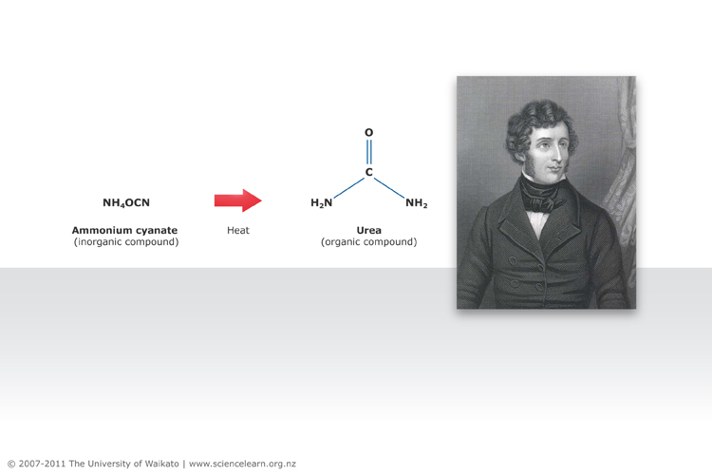
One of the most significant accomplishments was the synthesis by Friedrich Wohler of urea, a natural product of the body, from an inorganic compound, ammonium carbonate.
Notes:
Just as correlations were made between bedside findings and changes in the organs, so too was the chemistry laboratory brought to bear on understanding the functional alterations caused by disease. By the middle of the nineteenth century, examinations of blood and urine were routine

Slide 19
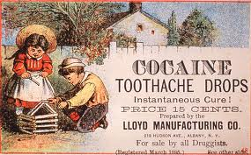
Pierre Robiquet was another of the many pharmacist-chemists in France and Germany who discovered and isolated the new plant alkaloids so important to medicine—among them atropine, colchicine, and cocaine.
Notes:
As advances in physiology and chemistry proceeded, it became possible to isolate drugs in pure form and thus examine their actions in animals and humans. Thus the discipline of pharmacology was developed. On the basis of preliminary investigations in France by J. F. Derosne in 1803 and A. Seguin in 1804, F. W. A. Serturner in Germany isolated morphine in 1806. Pelletier and Caventou in 1818 did the same in France with strychnine, quinine, and other drugs. Pierre Robiquet was another of the many pharmacist-chemists in France and Germany who discovered and isolated the new plant alkaloids so important to medicine—among them atropine, colchicine, and cocaine.

Slide 20
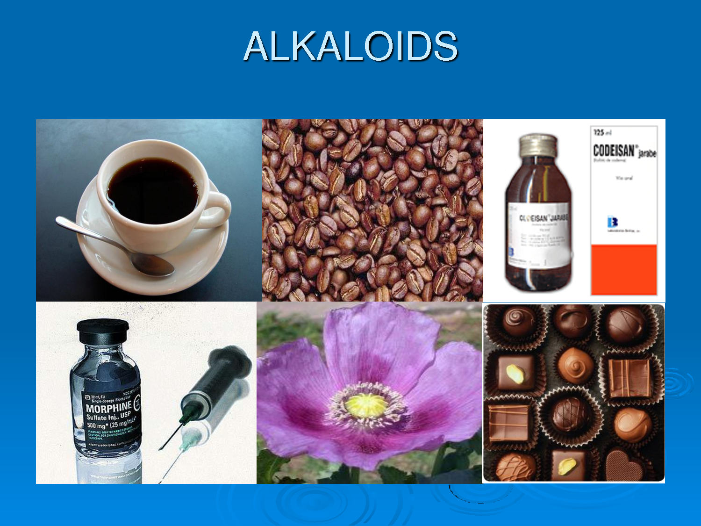
In England Alexander Crum Brown (1838-1922) and Thomas Frazer advanced the discipline by correlating the actions of drugs with their chemical composition. As more and more drugs were isolated and their chemical nature understood, it became possible to create therapeutic compounds by building them from basic units. Alkaloids and antipyretics (fever-lowering compounds) were among the first drugs synthesized.

Slide 21
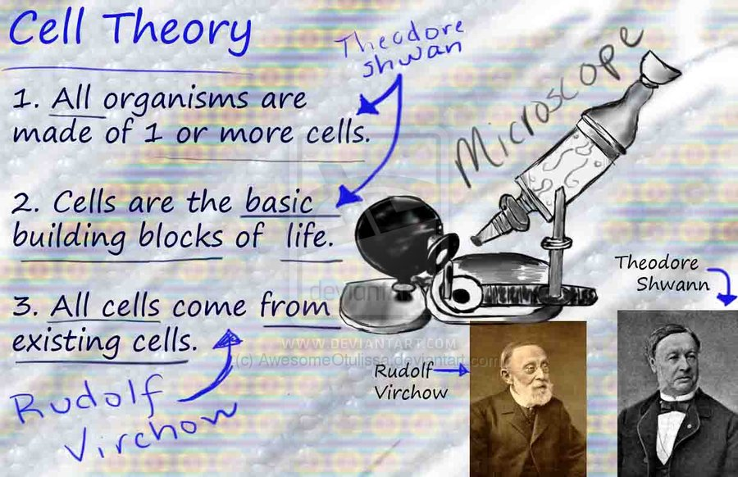
Cell Theory
Matthias Schleiden (1804-81) and Theodor Schwann (1810-82), developed one of the most important conceptions of modern biology.
Notes:
Matthias Schleiden (1804-81) and Theodor Schwann (1810-82), developed one of the most important conceptions of modern biology. Although it had been previously known that parts of plants were cellular, Schleiden was the first to state explicitly that each plant was a community of eels with each cell having a separate existence. Schwann generalized Schleiden's conclusions to all life—animal and plant. Much of the information that led to the understanding and elaboration of the cell theory depended on technical advances in microscopes.

Slide 22
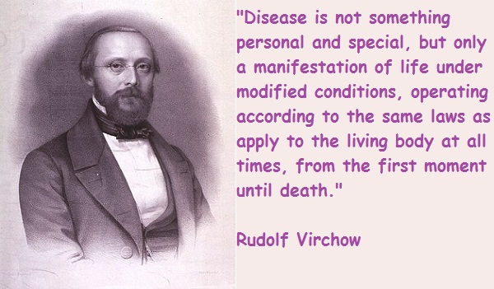
Rudolf Virchow established the proposition that cells arise only from preexisting cells.
Notes:
Even when the idea was accepted that all living creatures are composed of living cells, the question arose of how the cells originated. Schleiden proposed that the cell and its components formed as a result of a chemical precipitation out of an undifferentiated mass. It was Rudolf Virchow, who overthrew the speculative explanations and firmly established the proposition (in which he was joined by many other investigators) that cells arise only from preexisting cells. At first the view proposed by Schleiden was embraced by many outstanding scientists, including Karl Rokitansky, a great pathologist of the time, but the concept of Virchow finally gained full acceptance.

Slide 23
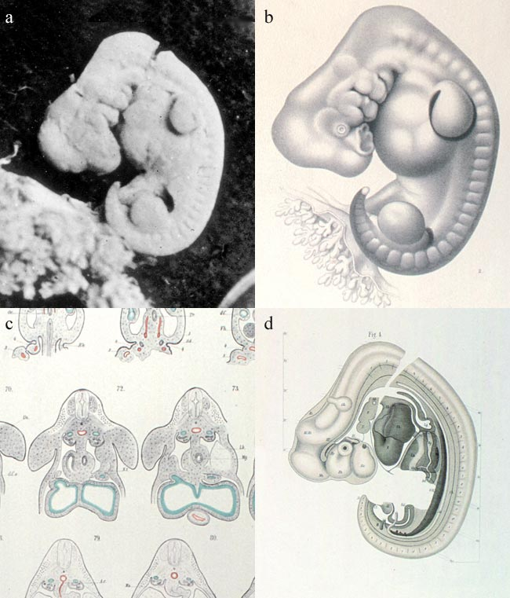
Microscopic Anatomy and Embryology
Robert Remak classified tissues according to their embryological origin into three primary systems (germ layers): ectoderm, mesoderm, and entoderm.
The mechanism of cell division, the means by which the embryo enlarges, organs increase, and tissues regenerate was reported by Walter Fleming in 1882.
Notes:
Jacob Henle (1809-85), was responsible for early ideas concerning microorganisms as causes of disease. Albert von Kolliker (1817-1905) wrote what may have been the first organized textbook on histology. The spermatozoan had been known for centuries, but Karl Ernst von Baer (1792-1876) gave the first description of the ovum (egg) of mammals. Robert Remak (1815-65) classified tissues according to their embryological origin into three primary systems (germ layers): ectoderm, mesoderm, and entoderm. The mechanism of cell division, the means by which the embryo enlarges, organs increase, and tissues regenerate was reported by Walter Fleming in 1882. Wilhelm Waldeyer (1836-1921) named the chromosome in the nucleus of the cell and put forth in 1891 the theory that the basic unit of the nervous system is the nerve cell, the neurone.

Slide 24
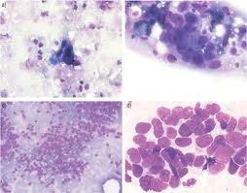
Pathology
In keeping with the spirit of correlating the clinical manifestations of illness with the pathological findings in organs, autopsies were the major focus in medicine.
Notes:
In keeping with the spirit of correlating the clinical manifestations of illness with the pathological findings in organs, autopsies were the major focus in medicine. In the French and British schools the availability of corpses for pathological examination was quite limited, whereas in Austria and Germany medical institutions were often the centers in which autopsies were performed, usually by one prosector and his pupils. Moreover, in France and Britain the principal pathological studies were made by the clinicians

Slide 25
CLINICAL SCHOOLS AND THE CLINICIANS
The outstanding characteristic of nineteenth-century medicine was the correlation of discoveries in the laboratory and autopsy room with observations at the bedside.
Notes:
The outstanding characteristic of nineteenth-century medicine was the correlation of discoveries in the laboratory and autopsy room with observations at the bedside, and it was principally the hospital where such investigations and interconnections were pursued. In the first half of the century, leadership in clinical science resided in France, but it later passed to the British Isles, and then to the German-speaking countries.

Slide 26
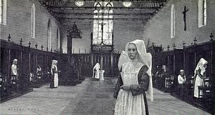
Paris
The hospital became more important as the focus of medical activity, public health measures were seen as a duty of government, and medical practice was open to all classes.
Notes:
An important factor in the emergence of Paris as the leading clinical school was the French Revolution. As the old regime was swept away, so were ancient ideas and inhibitions, opening the way to new approaches by experiment, an emphasis on pragmatism rather than theory, and bedside observation instead of reasoning by concept. The hospital became more important as the focus of medical activity, public health measures were seen as a duty of government, and medical practice was open to all classes. The wounds sustained in the savage turmoil of the Revolution and after had increased the need for surgery, and since physicians appeared to have little effect on illnesses and epidemics surgeons gained an equal status. Nevertheless, as surgery and medicine coalesced into one profession, specializations began to occur as the new discoveries accumulated.

Slide 27
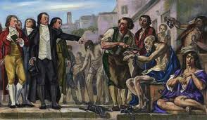
Philippe Pinel's close observation of people with mental illness and his astute evaluation of the results of treatment led him to advocate a change in insane asylums from forcible restraint to gentleness, persuasion, and a cheerful environment which benefited from the influences of family and friends.
Notes:
Philippe Pinel (1745-1826) was representative of both the eighteenth and nineteenth centuries. His concern for the classification of disease was a holdover from the past, and his concentration on objective clinical study in a special field fitted the trend toward specialization. Pinel's close observation of people with mental illness and his astute evaluation of the results of treatment led him to advocate a change in insane asylums from forcible restraint to gentleness, persuasion, and a cheerful environment which benefited from the influences of family and friends.

Slide 28
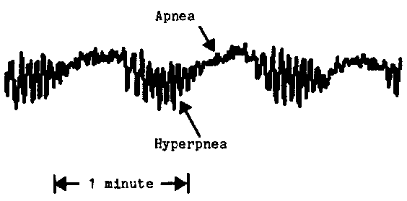
Dublin
John Cheyne (1777-1836), detailed accounts of a variety of diseases and his writings on education gained him a worldwide reputation as a great teacher and practitioner. The term "Cheyne-Stokes respiration," a type of irregular breathing, has remained in medical parlance.
Notes:
Philippe Pinel (1745-1826) was representative of both the eighteenth and nineteenth centuries. His concern for the classification of disease was a holdover from the past, and his concentration on objective clinical study in a special field fitted the trend toward specialization. Pinel's close observation of people with mental illness and his astute evaluation of the results of treatment led him to advocate a change in insane asylums from forcible restraint to gentleness, persuasion, and a cheerful environment which benefited from the influences of family and friends.

Slide 29
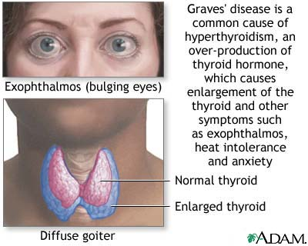
The most famous teacher of the Dublin group was Robert James Graves (1796-1853), He is the eponym ("Graves' disease") for that combination of thyroid enlargement, nervousness, sweating, and pronounced stare referred to as "toxic exophthalmic goiter." It was Graves who overturned the past dietary restrictions for patients with fever by urging a full, nutritious diet for all ill patients. He suggested that his own epitaph could well read, "He fed fevers."
Notes:
The most famous teacher of the Dublin group was Robert James Graves (1796-1853), whose bedside rounds were widely known as superb instructional exercises. He is the eponym ("Graves' disease") for that combination of thyroid enlargement, nervousness, sweating, and pronounced stare referred to as "toxic exophthalmic goiter." It was Graves who overturned the past dietary restrictions for patients with fever by urging a full, nutritious diet for all ill patients. He suggested that his own epitaph could well read, "He fed fevers."

Slide 30
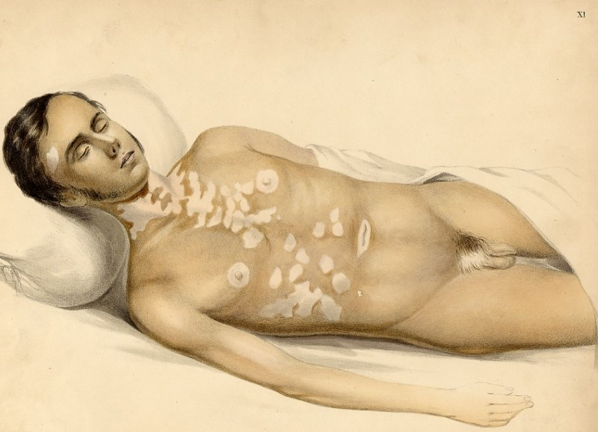
London and Edinburgh
Thomas Addison (1793-1860), whose severe, pompous manner, precisely chosen words, and physically impressive appearance struck fear into students. His thorough examinations and perceptive analyses earned him the awestruck respect of his colleagues. Pernicious anemia and adrenal insufficiency are both still referred to as "Addison's anemia" and "Addison's disease of the adrenals."
Notes:
Perhaps the most imposing of the leaders at Guy's was Thomas Addison (1793-1860), whose severe, pompous manner, precisely chosen words, and physically impressive appearance struck fear into students. His thorough examinations and perceptive analyses earned him the awestruck respect of his colleagues. Pernicious anemia and adrenal insufficiency are both still referred to as "Addison's anemia" and "Addison's disease of the adrenals."

Slide 31
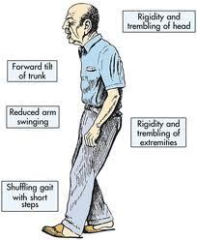
James Parkinson (1755-1824), gained recognition for his description of a neurological disorder now known as "Parkinson's disease.
Notes:
Perhaps the most imposing of the leaders at Guy's was Thomas Addison (1793-1860), whose severe, pompous manner, precisely chosen words, and physically impressive appearance struck fear into students. His thorough examinations and perceptive analyses earned him the awestruck respect of his colleagues. Pernicious anemia and adrenal insufficiency are both still referred to as "Addison's anemia" and "Addison's disease of the adrenals."

Slide 32
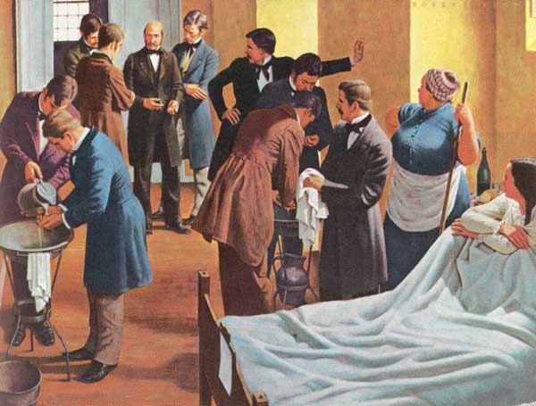
Antiseptics
1847: Ignaz Semmelweiss (Hungary) cut the death rate in his maternity ward by making the doctors wash their hands in calcium chloride solution before treating their patients.
1854: Standards of hospital cleanliness and nursing care rose rapidly under the influence of Florence Nightingale.
Notes:
Antiseptics
1847: Ignaz Semmelweiss (Hungary) cut the death rate in his maternity ward by making the doctors wash their hands in calcium chloride solution before treating their patients.
1854: Standards of hospital cleanliness and nursing care rose rapidly under the influence of Florence Nightingale.
1865: Joseph Lister (Scotland) - basing his ideas on Pasteur's Germ Theory cut the death rate among his patients from 46 to 15 per cent by spraying instruments and bandages with a 1-in-20 solution of carbolic acid.
1890: Beginnings of aseptic surgery - surgeons started boiling their instruments to sterilise them - WS Halstead (America) started using rubber gloves when operating - German surgeons started to use face masks.

Slide 33
1865: Joseph Lister (Scotland) - basing his ideas on Pasteur's Germ Theory cut the death rate among his patients from 46 to 15 per cent by spraying instruments and bandages with a 1-in-20 solution of carbolic acid.
1890: Beginnings of aseptic surgery - surgeons started boiling their instruments to sterilise them - WS Halstead (America) started using rubber gloves when operating - German surgeons started to use face masks.

Slide 34
More causes for improvements in surgery
The number of operations grew hugely through the century, and surgeons became skilled at internal operations (1880s: first appendectomy; 1896: first open-heart surgery) and even tried (unsuccessfully) to transplant organs such as thyroid glands and testicles. Various factors pushed the process along:
The Industrial Revolution / inventions
  Wilhelm Roentgen discovered x-rays - helped internal surgery.
  Public demonstrations (eg of anaesthesia) allowed knowledge of new procedures to spread.

Slide 35
More causes for improvements in surgery
.
Scientific knowledge
  The scientist Humphrey Davy had first discovered that laughing gas was an anaesthetic when working on the properties of gases in 1800.
  Joseph Lister lectured in King's College London, and published his findings in 'The Lancet'.
Social factors
  Queen Victoria gave birth to her children under anaesthesia (after which the general public's fear of anaesthesia lessened). Edward VII's appendectomy helped reduce fear of operations.
War
  The needs of army surgeons treating soldiers injured in battle (often requiring amputations) stimulated advance.
  The Crimean War led to the development of nursing (Florence Nightingale at Scutari).
  World War One led directly to the development of the National Blood Transfusion Service.

Slide 36
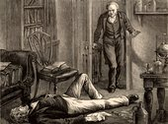
James Young Simpson (1811-70) introduced chloroform as an anesthetic. One evening Simpson and friends inhaled the substance at home and found they all had been rendered unconscious. Impressed by its effectiveness and pleasant smell, he tried it for operations and deliveries. For the next half-century, chloroform was the most frequently used anesthetic in Great Britain. Simpson also made many other contributions to obstetrics and gynecology.
Notes:
James Young Simpson (1811-70), perhaps the most famous obstetrician and gynecologist in Britain, born, trained, and nurtured in Scotland, introduced chloroform as an anesthetic. In his quest for a more pleasant and more controllable agent than ether, he had tried a drug suggested to him by a Liverpool chemist which had just been named "chloroform" by J. B. Dumas in Paris, but it had been discovered earlier, in the 1830s, by each of three independent investigators: One evening Simpson and friends inhaled the substance at home and found they all had been rendered unconscious. Impressed by its effectiveness and pleasant smell, he tried it for operations and deliveries. For the next half-century, chloroform was the most frequently used anesthetic in Great Britain. Simpson also made many other contributions to obstetrics and gynecology.

Slide 37
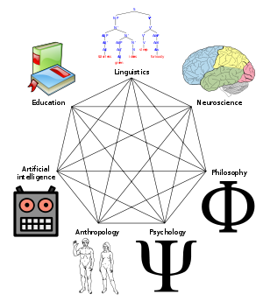
Germany
The theorizing, mystical Naturphilosophie which enveloped scientific and medical thinking in Germany in the early part of the century gradually gave way to direct observation and experiment, with the establishment of laboratory studies on body functions.
Notes:
The theorizing, mystical Naturphilosophie which enveloped scientific and medical thinking in Germany in the early part of the century gradually gave way to direct observation and experiment, with the establishment of laboratory studies on body functions led by Johannes Muller and his followers.
Meanwhile a clinical school was emerging all over Germany, not in just one or two cities; possibly this was because Germany at the beginning of the century was a conglomeration of divided, independent political units, with no one central city representing the focus of feeling or governmental organization. Johann Lukas Schonlein (1793-1864), erected a classification of diseases, as a Natural History school, which turned out to be so arbitrary and artificial that it did not outlast him. But his intensive use of percussion and auscultation, incisive lectures and clinical demonstrations, and emphasis on the newest methods, including examination of the blood and urine, made him a leader in clinical medicine. His name was given to a bleeding disease, "Schonlein's purpura," and to a parasitic fungus, Achorion (or Trichophyton) schonleini

Slide 38

METHODS OF TREATMENT
In the 19 с, the principal therapies open to European and American physicians were general regimens of diet, exercise, rest, baths and massage, bloodletting, scarification, cupping, blistering, sweating, emetics, purges, enemas, and fumigations. There were multitudes of plant and mineral drugs available, : quinine for malaria, digitalis for heart failure, colchicine for gout, and opiates for pain.
Notes:
In the early years of the nineteenth century, the principal therapies open to European and American physicians were general regimens of diet, exercise, rest, baths and massage, bloodletting, scarification, cupping, blistering, sweating, emetics, purges, enemas, and fumigations. There were multitudes of plant and mineral drugs available, but only a few rested on sound physiological or even empiric foundations: quinine for malaria, digitalis for heart failure, colchicine for gout, and opiates for pain. Many physicians continued to use compounds of arsenic for such diverse complaints as intermittent fever, paralysis, epilepsy, edema, rickets, heart disease, cancer, skin ulcerations, parasites, indigestion, and general debility. Antimony, which had its heyday in a previous century, was also still much in use, possibly sometimes aiding patients with parasitic infestations.

Slide 39
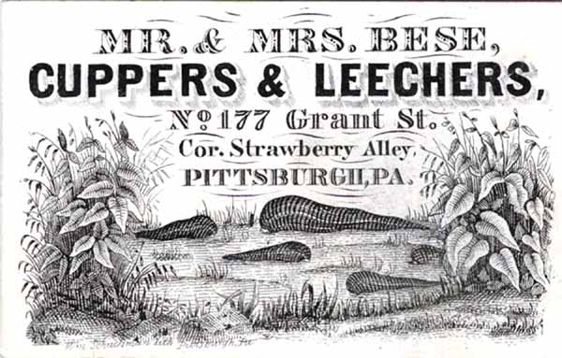
METHODS OF TREATMENT
"desperate diseases require desperate measures”
Notes:
In the early years of the nineteenth century, the principal therapies open to European and American physicians were general regimens of diet, exercise, rest, baths and massage, bloodletting, scarification, cupping, blistering, sweating, emetics, purges, enemas, and fumigations. There were multitudes of plant and mineral drugs available, but only a few rested on sound physiological or even empiric foundations: quinine for malaria, digitalis for heart failure, colchicine for gout, and opiates for pain. Many physicians continued to use compounds of arsenic for such diverse complaints as intermittent fever, paralysis, epilepsy, edema, rickets, heart disease, cancer, skin ulcerations, parasites, indigestion, and general debility. Antimony, which had its heyday in a previous century, was also still much in use, possibly sometimes aiding patients with parasitic infestations.

Slide 40
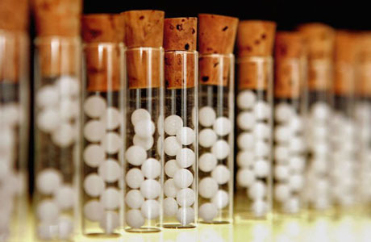
Medical Systems
Perhaps the most influential system was homeopathy, a creation of Samuel Hahnemann (1755-1843) which taught that drugs which produced symptoms in a person resembling those of a specific illness would cure the patient if used in smaller amounts.
Notes:
Claude Bernard wrote, "Systems do not exist in Nature but only in men's minds." Nevertheless, numerous systems of therapy and explanations for illness flourished in the nineteenth century, a few of which may be mentioned. Some now seem close to quackery, but generally these theories of disease and treatment were sincere attempts to reconcile the symptoms of an illness with current knowledge.
Perhaps the most influential system was homeopathy, a creation of Samuel Hahnemann (1755-1843) which taught that drugs which produced symptoms in a person resembling those of a specific illness would cure the patient if used in smaller amounts. The doctrine spread throughout the world and was especially popular in the United States, where schools of homeopathy were founded, notably in Philadelphia and New York.

Slide 41
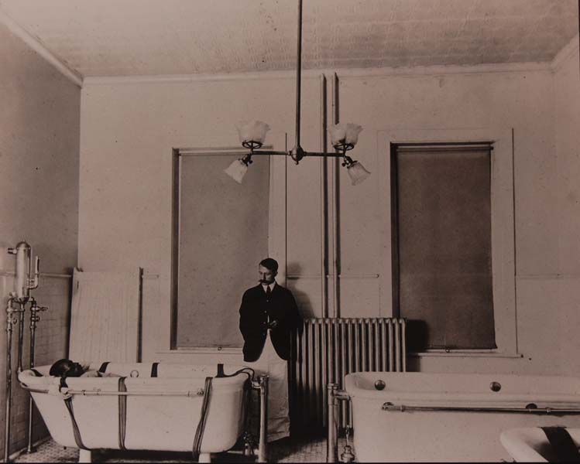
Hydrotherapy, an all-purpose therapy, was based on the ancient concepts of the humors—the necessity for expelling excesses.
The opposite view—using only dry foods and substances—also had advocates, but they were few.
Notes:
Hydrotherapy, an all-purpose therapy, was based on the ancient concepts of the humors—the necessity for expelling excesses. Vincenz Priessnitz (1799-1851) the principal proponent, administered water in every conceivable way, but his regimen also included simple, nourishing food and exercise. This system, which achieved great popularity, led to the founding of hydropathic institutions in Europe and the United States. The opposite view—using only dry foods and substances—also had advocates, but they were few. The Thomsonians, who emphasized herbal medicines and steam baths, were one of a diverse group of practitioners—prominent especially in the U.S.—who stressed "Nature's remedies and folk medicine."

Slide 42
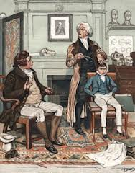
Another medical therapy was cranioscopy, фlso called phrenology, the doctrine was promulgated by Franz Joseph Gall (1758-1828 He taught that the shape and irregularities of the skull were projections of the underlying brain and consequently indications of a person's mental characteristics—a conclusion with no basis in fact.
Notes:
Another medical therapy, which arose in the eighteenth century but had a strong impact throughout the world in the following century, was cranioscopy. Also called phrenology, the doctrine was promulgated by Franz Joseph Gall (1758-1828), a clinician born in Germany and educated in France and Austria, who practiced and lectured in Paris for over twenty years. He taught that the shape and irregularities of the skull were projections of the underlying brain and consequently indications of a person's mental characteristics—a conclusion with no basis in fact. Gall's concept of localizing mental processes was a good idea, but his uncritical exaggerations carried it too far. However, the very notion that the brain is a composite of discrete but interrelated functions anatomically confined to specific areas, an old but incompletely realized concept, was a principle that was to become the basic tenet of brain physiology.

Slide 43
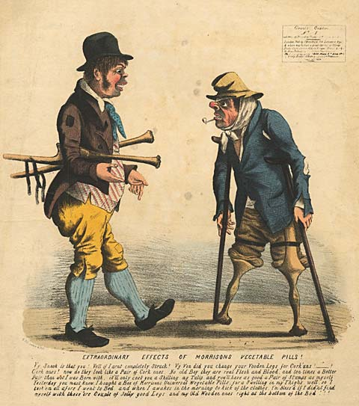
"Universal Pills"

Slide 44
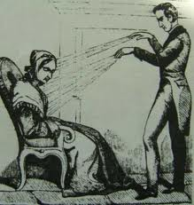
Mesmerism, or "animal magnetism" also played a part in opening minds to the possibilities of making people insensitive to pain.
Notes:
Mesmerism, or "animal magnetism" (although branded quackery it was an early form of hypnotism), also played a part in opening minds to the possibilities of making people insensitive to pain. Although James Esdaile in India, stimulated by the publications of John Eliotson, performed seventy-three painless operations of different types using mesmerism, the medical profession worldwide remained unconvinced. Indeed, upon John Eliotson (1791-1868), the principal advocate of mesmerism, the brunt of denunciation fell. The hostile reception that his demonstrations and writings received led to his virtual ostracism. A well-trained, energetic investigator and practitioner, he seems always to have been eager to embrace new ideas, though sometimes with insufficient critical evaluation. For instance, his vigorous espousal of phrenology was one of the reasons for opposition to his reports. On the other hand he had been among the first to take up Laennec's stethoscope, a step so unusual at the time that it also counted against him among his colleagues.

Slide 45
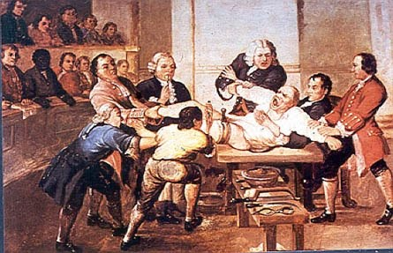
Anesthesia
Surgery made steps forward very slowly, limited as it was by lack of effective pain control during operations and by devastating postoperative infections. Both of these obstacles were substantially lifted by the discovery of anesthesia and the proof that germs caused infection.

Slide 46
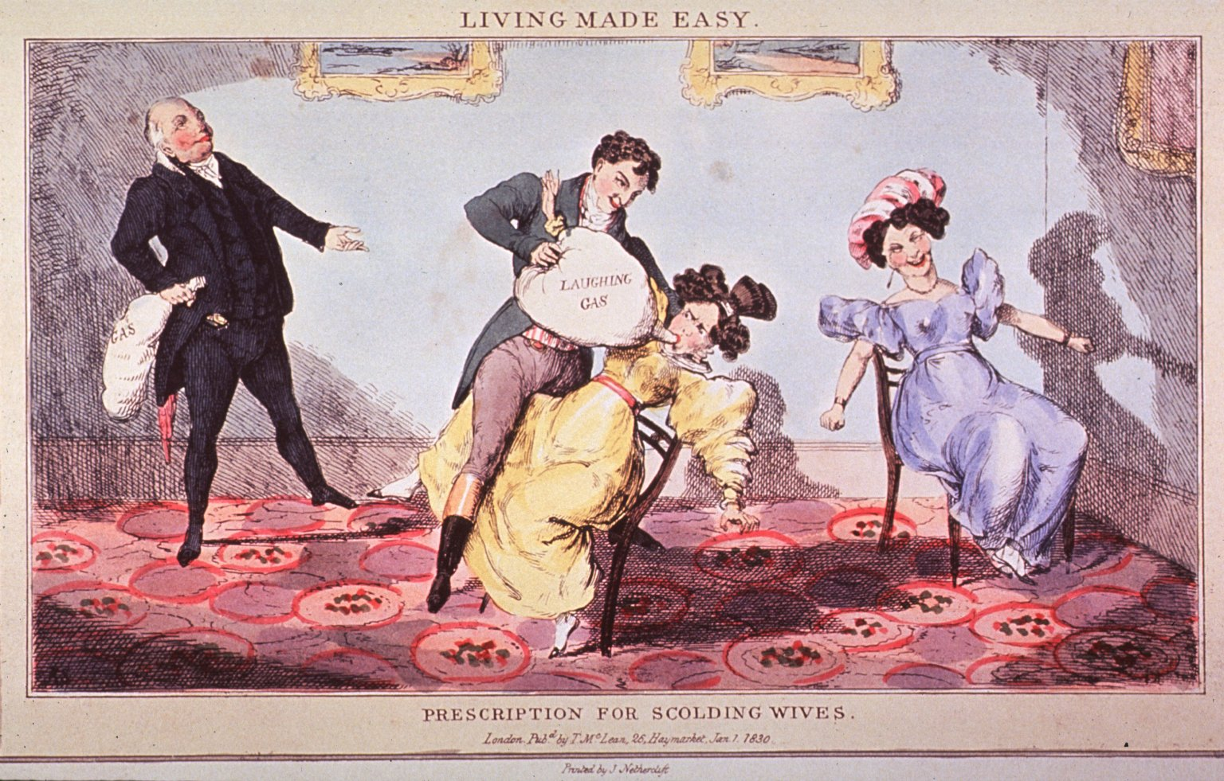
In 1772, Joseph Priestley discovered nitrous oxide gas. Later, whiffs of nitrous oxide (soon called "laughing gas") were indulged in at "revels" for social amusement and the euphoria produced. Noting a reduced sensitivity to pain in these "revelers," Humphry Davy (1778-1829) suggested that "laughing gas" might be useful to surgery, but no one followed up his suggestion.
Other means of preventing pain through the loss of consciousness were also put forth from time to time. Henry Hill Hickman in 1824 produced a state of "suspended animation" in animals through asphyxia achieved by inhalation of carbon dioxide, which permitted him to perform operations without causing pain. He recommended this technique for use on humans but could not convince scientists.

Slide 47
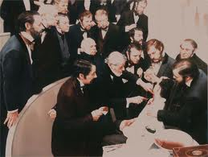
As anatomical knowledge and surgical techniques improved, the search for safe methods to prevent pain became even more pressing. The advent of professional dentistry added a new urgency to this quest because of the sensitivity of mouth and gums. Although death as an alternative frequently drove patients to the surgeon, few people were known to die from toothache. The urge to see a dentist was easily resisted, so it may be more than coincidence that dentists seized the initiative in the quest for freedom from pain.

Slide 48
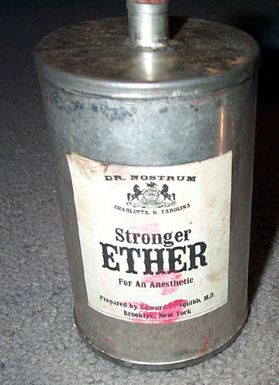
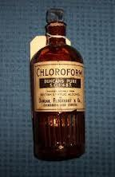
By 1831 all three basic anesthetic agents—ether, nitrous oxide gas, and chloroform—had been discovered, but no medical applications of their pain-relieving properties had been made. In all likelihood the first man to apply his social experiences with laughing gas to surgery was Dr. Crawford W. Long (1815-78) of Georgia. In 1842 he performed three minor surgical procedures using sulfuric ether. Apparently not realizing the significance of what he had done, Long made no effort to publicize his discovery until several years later when anesthesia had been hailed as a major breakthrough.

Slide 49
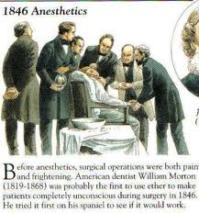
A Connecticut dentist, Dr. Horace Wells (1815-48), on learning of the peculiar properties of nitrous oxide in 1844, tested them by having one of his own teeth removed while under the influence of the gas. Delighted with the results, he administered it to several patients, and then demonstrated his procedure before Dr. John C. Warren's medical class at Harvard. For some inexplicable reason, the patient cried out, and Wells was booed and hissed. Following Wells's failure, his friend and fellow dentist William T. G. Morton (1819-68) began experimenting with sulfuric ether. Encouraged by its effectiveness in his dental practice, he, too, contacted Dr. Warren and in 1846 gave the first public demonstration of surgery without pain. News of this momentous event spread rapidly throughout the Western world, and a new era for surgery began. Until Oliver Wendell Holmes supplied the name "anesthesia," the Boston medical community had been at a loss for a term to describe the condition brought on by this new agent.

Slide 50
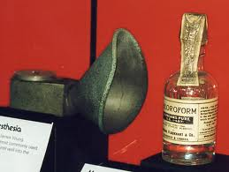
After ether was widely accepted, James Simpson in Edinburgh abandoned it for chloroform because of its disagreeable odor, irritating properties, and long induction period. For about a century, chloroform continued to be the choice agent in Britain until its unmanageable toxicity and delayed damage to the liver was appreciated. In Germany, even when in 1894 the superior safety of ether over chloroform had been clearly shown (a more than five times higher mortality for chloroform), chloroform remained the favored anesthetic for almost twenty-five years.

Slide 51
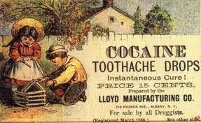
Other anesthetic agents were introduced near the end of the century. Ethyl chloride was sprayed locally to induce insensitivity. Cocaine by topical application to the eye was reported by Carl Koller in 1884. Sigmund Freud had earlier studied the anesthetic properties of cocaine but did not pursue the work. The injection of cocaine into nerve trunks to block sensation was investigated by William Halsted in the United States. Cocaine was also the first drug injected into the spinal canal in 1898 to produce anesthesia, but once its dangers were realized other less toxic and nonhabituating agents were developed. Numerous methods of administering anesthetics were tried, and the rectal route was introduced by Pirogov in Russia. Ore of France originated the intravenous method in 1874. After Fischer in 1902 had synthesized veronal, this barbiturate and other safer and more manageable agents for intravenous use were developed.

Slide 52
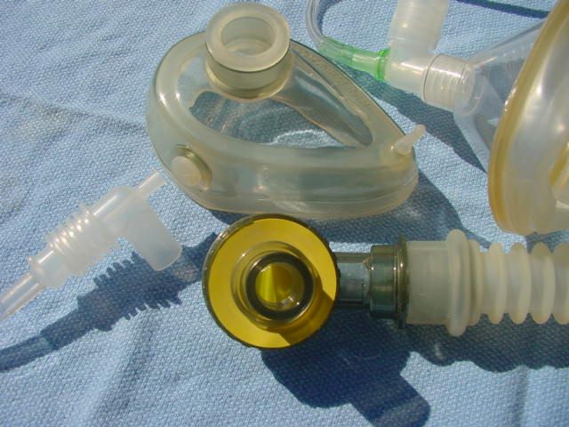
The "open" method of dripping the anesthetic on a gauze mask was replaced by "closed" systems in which an airtight mask could deliver a precisely measured amount of vapor and remove the exhaled carbon dioxide through absorption by a calcium compound. Advantages were also perceived in the insertion of tubing through the mouth and voice box into the trachea, thereby preventing the aspiration of secretions and controlling the patient's respiration. The twentieth century saw refinements in endotracheal anesthesia which permitted an anesthetist to control the flow of air, oxygen, and other gases into the lungs and thus have complete mastery over breathing during an operation. Muscle-relaxing drugs were also put to use in placing the anesthetist in control of respiratory movements and the surgeon in a position to perform manipulations through a totally relaxed abdominal wall.

Slide 53
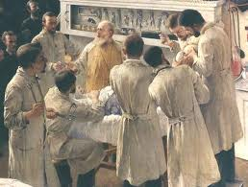
Surgery
When anesthesia had become commonplace and the limitations of pain had disappeared, surgical procedures multiplied in number and complexity. No longer did the operator have to place the first emphasis on speed and to limit his manipulations mainly to surface areas of the body and the skeletal system. Yet the potential benefits of surgery were overshadowed by the frequent, devastating infections which often resulted in death. Outstanding surgeons everywhere were continually plagued by the dread complications of postoperative purulent infection and gangrene. Only when the bacterial origin of disease had been discovered and the necessity for keeping germs away from the operative field had been proved, notably by Lister, could surgery enter with safety the interior regions of the body. Every country participated in the new age of surgical progress, but the German-speaking countries were early at the forefront.

Slide 54
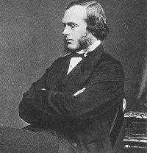
Joseph Lister
When Joseph Lister began his medical and surgical career, anesthetics were just beginning to be developed. This, of course, made the surgery a horrible experience for the patient. Of even greater significance was the lack of sterile surgical techniques. The concept that infections were caused by identifiable organisms (germ theory) was not yet known. So, when Lister began to sterilize his surgical instruments and dressings, his colleagues viewed him with great skepticism. But, Lister was convinced of his theories and he persisted. His experiments proved him to be right and, thanks to the "Father of Modern Surgery," sterile surgical procedures became the standard practice we enjoy today.

Slide 55
Surgery in Lister's time was a risky business. The term "Hospitalism" was coined to describe the collection of life threatening infections that often occurred following surgery. Though 50 percent of all surgical patients died, both surgeons and society accepted this as being an unpleasant, but unavoidable, side effect. It's hard to imagine the conditions that existed, given today's strict adherence to sterile surgeries. Surgeons actually felt a sense of pride in wearing blood-covered surgical garments, seeing them as a status symbol. The never even considered washing their hands between surgeries, or before examining the next patient. They felt this way because they believed the transmission of disease was, literally, out of their hands. There were two prevailing theories of disease the surgeons clung to, neither of which pointed to them having any involvement in the spread of infections. The first was "miasma," the belief that disease was carried about by noxious gases floating in the air. Their second theory was that the infections in the patient's wounds occurred spontaneously, being generated by some unknown, and unavoidable, action within the flesh itself. Both theories meant the surgeons had no responsibility in causing their patient's infections - and the death tolls continued to rise.

Slide 56
Lister had other ideas. He was appointed director of the Glasgow Royal Infirmary's new surgical building in 1861. The building had been erected in hopes of reducing the widespread surgical deaths at the existing facility. But, the deaths continued, with a mortality rate of close to 50 percent during Lister's first four years. Then Lister observed a phenomenon that captured his attention. Patients with simple fractures (those not piercing the skin) survived, but patients with compound fractures (those in which the bone pierces the skin) often died. He wanted to know why, and he began to formulate a theory. He hypothesized that the infections were not spontaneous, but were caused by an outside agent. So, Lister began to wear clean surgical garments and to wash his hands before surgery. Then, after being given a research paper by Louis Pasteur, Lister had his breakthrough. Pasteur had shown that faulty fermentation of wine, which resulted in undrinkable sour wine, was caused by outside germs entering the wine. Lister made the immediate connection to his own quest. He knew if infections arose spontaneously from the wounds there was nothing that could be done to cure them. But, if they developed because of a germ entering from the outside of the wound, there was hope - they could be prevented. Lister had heard that carbolic acid (phenol) was being used to safely kill parasites found in sewage. So, he began using a formulation of diluted carbolic acid to wash his surgical instruments, his hands, and wound dressings. He also instructed his surgeons to spray the air in the operating rooms with the carbolic acid mixture, to eliminate airborne germs. His techniques were remarkably successful.
He announced his success at a meeting of the British Medical Association in 1867: his surgical wards had been free of sepsis (an infection spreading throughout the body) for a miraculous nine months. This was unheard of in surgical wards, where death tolls continue to soar. Still, his breakthrough didn't lead to immediate acceptance. It would take well over a decade before his sterile techniques were widely adopted. Germanyled the way, in the 1870s, employing Lister's techniques during the Franco-Prussian war. But it was Lister himself, after successfully demonstrating his antiseptic surgical technique in London, which finally turned the tide. The news of the surgery caused intense interest, especially among Lister's critics. When the patient survived, without developing an infection, his critics could resist no longer. Lister's antiseptic surgical techniques became common practice

Slide 57

He announced his success at a meeting of the British Medical Association in 1867: his surgical wards had been free of sepsis (an infection spreading throughout the body) for a miraculous nine months. This was unheard of in surgical wards, where death tolls continue to soar. Still, his breakthrough didn't lead to immediate acceptance. It would take well over a decade before his sterile techniques were widely adopted. Germanyled the way, in the 1870s, employing Lister's techniques during the Franco-Prussian war. But it was Lister himself, after successfully demonstrating his antiseptic surgical technique in London, which finally turned the tide. The news of the surgery caused intense interest, especially among Lister's critics. When the patient survived, without developing an infection, his critics could resist no longer. Lister's antiseptic surgical techniques became common practice

Slide 58

THE PROFESSION
In the early half of the century, advances in physiology, pathology, and chemistry were not reflected in medical practice, for the physician's equipment was still limited. Doctors were even considered useless or harmful by large segments of the public conditioned by the failure of bleedings, purgings, and other manipulations to affect illness or stem epidemics and by the extravagant but convincing claims and cures promised by quacks. Attacks on nostrums and patent medicines were unpopular and generally ignored.
A dichotomy existed, especially in England, between those who favored mandatory licensing control over all healers, including physicians, and those who strongly advocated allowing anyone to practice medicine, giving patients a choice from among many practitioners and claimants. Political progressives believed that regulation would lead to domination and self-serving restriction of others by the medical profession; conservatives preached that only official bodies could or should determine who was fit to treat people.

Slide 59
Education and Licensure
By the eighteenth century in England, medical education was entirely in the hands of individual doctors, mostly but not exclusively surgeons, who had their own private schools which dealt principally with anatomy and surgery until other subjects were later added. Although the teachers, such as the Hunter brothers, often imparted a high order of instruction, the students received their clinical education by walking around the wards observing the leaders in the great institutions of London: St. Bartholomew's, St. Thomas's, St. George's, Guy's, London, and Middlesex hospitals. In contrast, Edinburgh had a regular medical school, operational since 1736, with formal courses of instruction which included regular lectures and bedside teaching.

Slide 60

The first medical school in America to lead the reform movement was associated with Lind University in Chicago (later Chicago Medical College and presently Northwestern University). In 1859 Lind raised its entrance requirements and lengthened its academic year to five months. The school received no support in its fight to raise educational standards until 1871, when Harvard overhauled its medical school and instituted a three-year graded course, a nine-month academic year, and written and oral examinations. Despite a better than forty percent drop in enrollment, Harvard persisted, and within a few years Pennsylvania, Syracuse, and Michigan swung into line.

Slide 61

In France, the decrees of Napoleon in 1803 categorized those who could practice medicine into doctors of medicine, doctors of surgery, and health officer doctors, each division with its own educational prerequisites and licensing examinations. Schools for apothecaries were built and a system ordered for inspecting the shops of apothecaries, druggists, and spicers. Tuition at all of the four state medical schools was kept low to permit students of limited means to enter the medical profession.

Slide 62

In Germany, the regulations varied in the different principalities. In the Duchy of Nassau, for instance, before it was taken over and surgeons were in one body under by Prussia, the physicians the state, and although strict examinations had to be passed to practice medicine a university degree was not essential. In Prussia, in 1825, three classes of licensed doctors were recognized: graduate physicians (who had to spend four years at a university and pass rigorous state examinations—including an additional test for those who entered surgery); wound doctors, first class (with fewer years of schooling and less difficult examinations); and wound doctors, second class (with even less education and less rigorous examinations). Obstetricians, ophthalmologists, and public health doctors also had separate requirements.

Slide 63

State practice of medicine and social insurance were also seen in the German principalities, where the physicians were paid by the state but were also permitted some private practice. In Prussia, the proportion of doctors who depended on state stipends became less and less. Bismarck finally turned to medical and social insurance as a means of receiving the support of the general populace in his aim of unifying Germany.

Slide 64

In Russia, after 1864, local governmental organizations, the zemstvo, were responsible for medical service to the poor and mentally ill and acted as public health overseers. The feldsher, a combination of male trained nurse and pharmacist who went out into the countryside, was also a provider of health care. Regular physicians continued to be trained in the large city universities.

Slide 65
THANK
YOU FOR YOUR ATTENTION!

