Slide 1
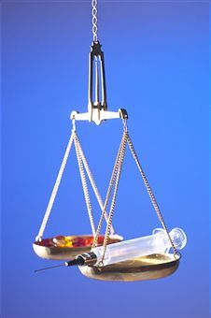
BIOETHICS: SUBJECT AND PURPOSE OF STUDY. MAIN BIOETHICAL THEORIES AND PRINCIPLES. ETICAL ISSUES IN MODERN MEDICINE.

Slide 2
PLAN
Definition of terms “ethics” and “bioethics”.
Subject of study.
Importance of bioethics.
Principles in medical ethics.
Ethical theories.
Ethical issues in modern medicine.

Slide 3
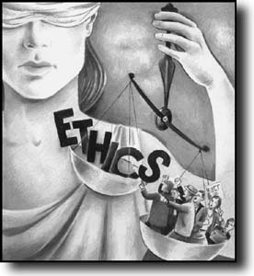
What is “ethics”?
  Ethics: “the rules of conduct recognized in respect to a particular class of human actions or a particular group, culture”

Slide 4
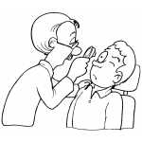
  Bioethics: “a field of study concerned with the ethics and philosophical implications of certain biological and medical procedures, technologies, and treatments, such as organ transplants, genetic engineering, and care of the terminally ill”
Notes:
We in fact cannot trace the origin of bioethics back to their beginning, as the relationships between human beings within their society, within the biological community, and with nature and God, are formed at an earlier stage then our history would tell us. The ethical principle of beneficence, which we could say means loving good, requires us to develop ways to help others in the world.
The social and ethical issues raised by the use of modern biotechnology are being more widely discussed every year. Events such as the cloning of mammals have raised even wider debate on these topics, and have filled the imagination of many people across the globe. Citizens of all ages need to make ethical decisions on how they use science and technology and its products.

Slide 5
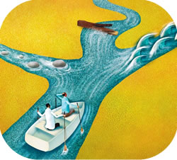
Bioethics is both a word and a concept. The word comes to us only from 1970 yet the concept comes from human heritage thousands of years old. Bioethics is love of life, balancing benefits and risks of choices and decisions. This heritage can be seen in all cultures, religions, and in ancient writings from around the world.

Slide 6
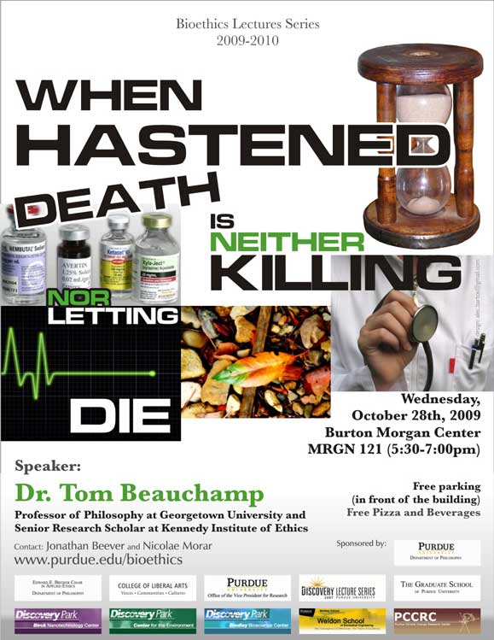
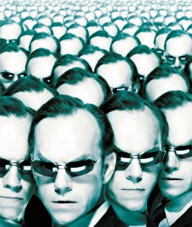
SUBJECT OF STUDY
Bioethics is the study of the ethical issues raised by the biological and medical sciences, and of questions of life and death as they arise in the context of healthcare. It seeks to address question such as:
Is there a difference between killing and 'letting die'?
Is there anything wrong with human cloning?
Does society have an obligation to provide universal healthcare?
What are the social and political implications of the new genetic technologies?
Notes:
Bioethics is a fascinating, challenging, enjoyable, and intensely relevant field of study, which draws on philosophy, science, sociology, and other disciplines, in the attempt to answer these and similar questions. It is an area of philosophy where the practical applications are obvious and where developments in the sciences continually pose new problems and open up new areas of research.

Slide 7
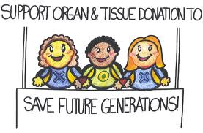
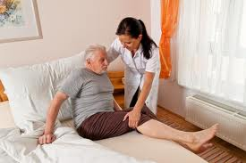
SUBJECT OF STUDY
It is a fact of modern life that most individuals will, at some stage of their lives, face decisions which involve fundamental questions in bioethics. Whether it's choosing whether or not to have a child, deciding to become an organ donor, considering being tested for a genetic condition, or making a decision about the care of elderly parents, most of us will not be able to avoid confronting bioethical issues.

Slide 8
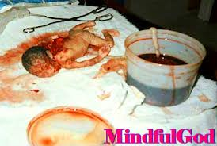
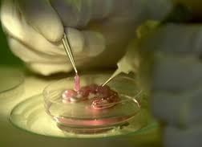
SUBJECT OF STUDY
Some of the most controversial and important public issues today are also questions of bioethics:
What should the law say about abortion?
Is there enough funding for public hospitals?
Should the government fund stem cell research involving human embryos?

Slide 9
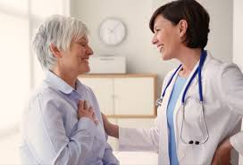
A knowledge of bioethics will empower you to make these decisions and to participate in these debates in an informed, critical and effective manner.

Slide 10
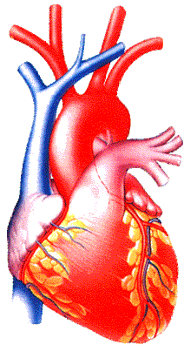
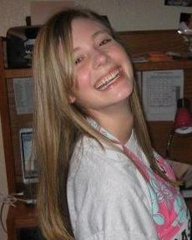
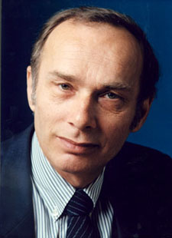
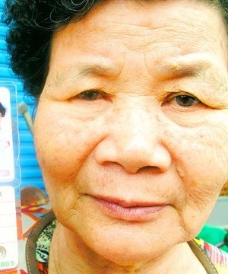
A classic bioethical decision
One heart available → who should get it?
  40-year-old school principal
  70-year-old woman
  17-year old girl

Slide 11
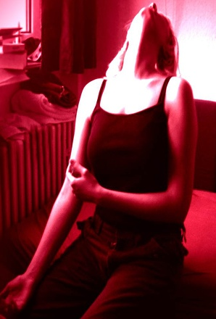
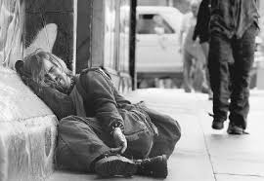
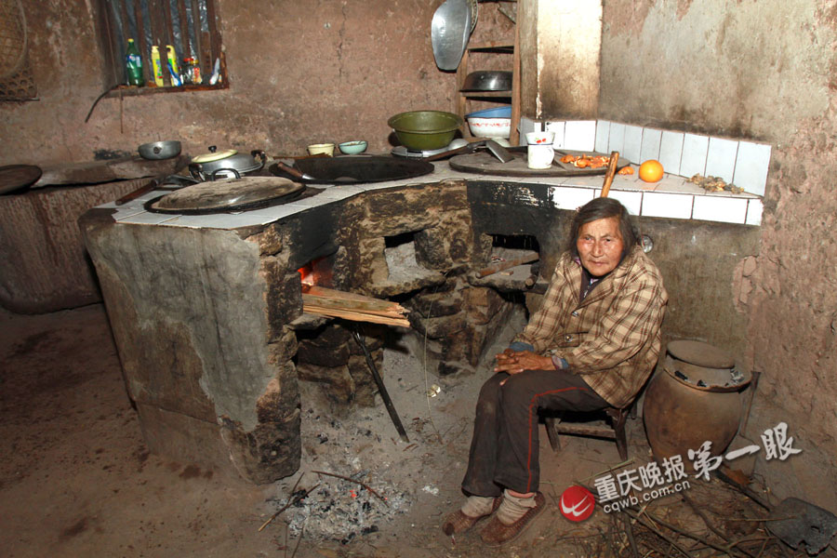
A classic bioethical decision
One heart available → who should get it?
  40-year-old man
  70-year-old woman
  17-year old girl

Slide 12

IMPORTANCE OF BIOETHICS
Ethics is not the study of what is legal or socially accepted or tolerated; it is the study of what is right and wrong.
Notes:
Moreover, there are wrong or morally bad laws and rules. And it is not always the case that they should be obeyed until they can be changed, because sometimes they are so bad that obedience to them is a greater moral transgression than disobedience.
And a rule-based set of ethics is problematic for two other reasons: (1) even if you could have a complete set of rules that would all be right for every situation, you likely could not know or remember them all or know which one to apply in which case. (2) In any formal, rule-based system, if a rule happens to be mistaken, it is still the rule you have to follow. Bad rules are rules nevertheless if your system is such that you must obey the rules no matter what.

Slide 13
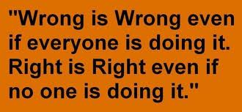

Slide 14
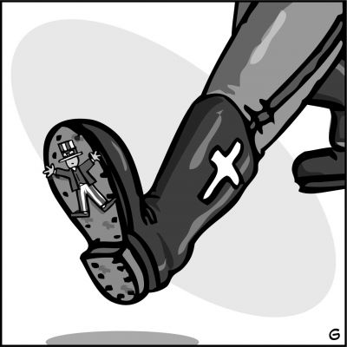
There are wrong or morally bad laws and rules.
Sometimes they are so bad that obedience to them is a greater moral transgression than disobedience.

Slide 15
Ethical theories and principles are the foundations of ethical analysis.
Ethical principles are the common goals that each theory tries to achieve in order to be successful.

Slide 16
Ethical Theory…to Action
Theory
Principle
Rule
Action
Notes:
*

Slide 17

Principles in medical ethics
Autonomy - the patient has the right to refuse or choose his treatment.
(Voluntas aegroti suprema lex.)
Benificence - a practitioner should act in the best interest of the patient.
(Salus aegroti suprema lex.)
Non-maleficence - "first, do no harm" (primum non nocere).
Justice - concerns the distribution of scarce health resources, and the decision of who gets what treatment (fairness and equality).

Slide 18
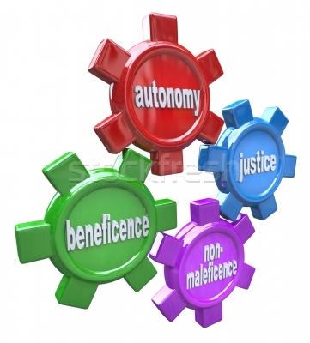
Principles in medical ethics
When moral values are in conflict, the result may be an ethical dilemma or crisis.

Slide 19
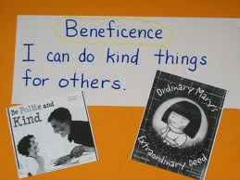
Beneficence
The term beneficence refers to actions that promote the well being of others.
In the medical context, this means taking actions that serve the best interests of patients.

Slide 20
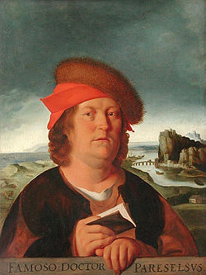
Beneficence
These duties are viewed as self-evident and are widely accepted as the proper goals of medicine.
The author of this principle – PARACELS.

Slide 21
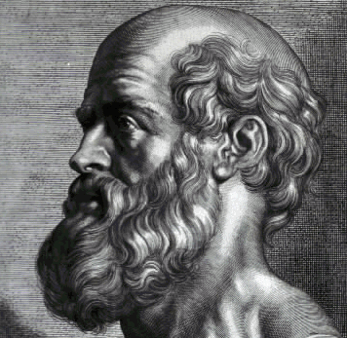

The Principle of Non-maleficence
This is similar to beneficence, but deals with situations in which neither choice is beneficial. In this case, a person should choose to do the least harm possible and to do harm to the fewest people.

Slide 22
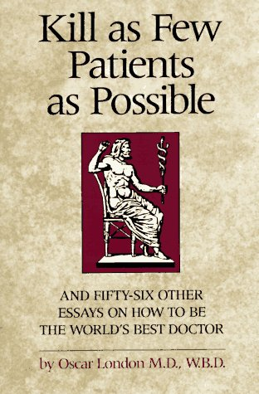
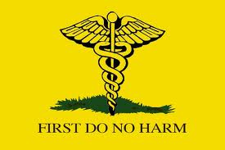
Non-Maleficence
"The treatment was a success, but the patient died."

Slide 23
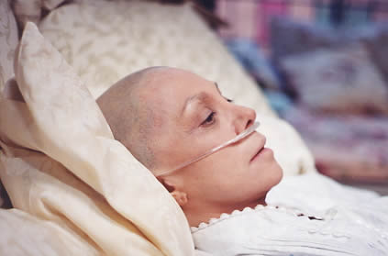

Respect for Autonomy
In the paternalistic viewpoint, an authority prioritizes a dependent person's best interests over the dependent person's wishes.

Slide 24
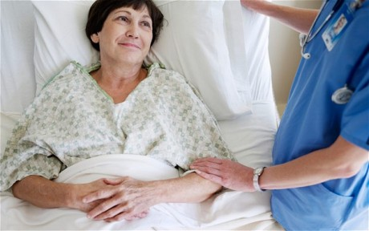
Respect for Autonomy
A second way in which to view the respect for autonomy is the libertarian view. This standpoint prioritizes the patient's wishes over their best interests.

Slide 25
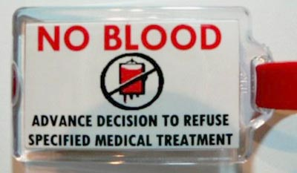
Case 1: Jehovah's witness
16 year old male
Car accident
Requires surgery
Parents will not allow blood products to be used
Patient refuses blood products
Notes:
*

Slide 26
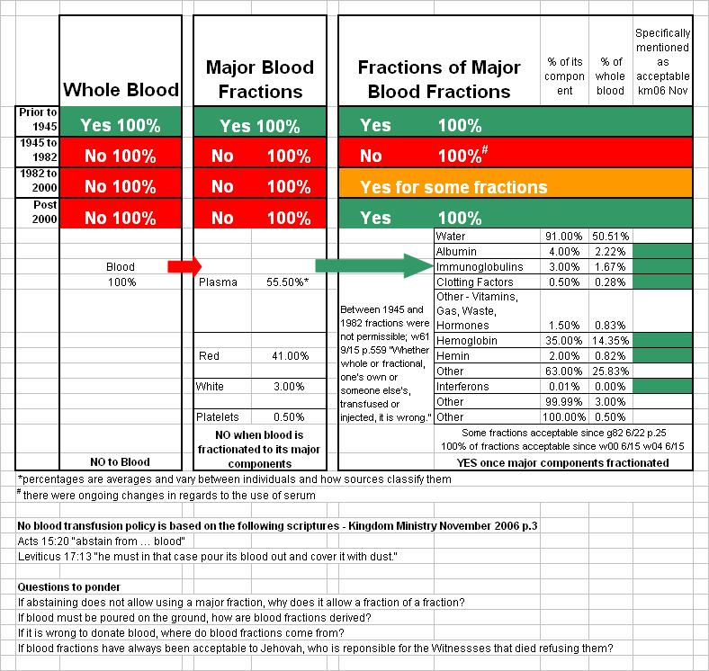

Slide 27
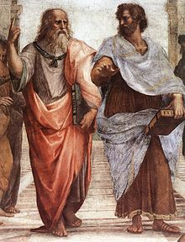
Justice
Justice in health care defined as a form of fairness, or as Aristotle said, "giving to each that which is his due.“
Persons who are equals should qualify for equal treatment

Slide 28
JUSTICE
In fact, our society uses a variety of factors as a criteria for distributive justice, including the following:
to each person an equal share
to each person according to need
to each person according to effort
to each person according to contribution
to each person according to merit
to each person according to free-market exchanges

Slide 29
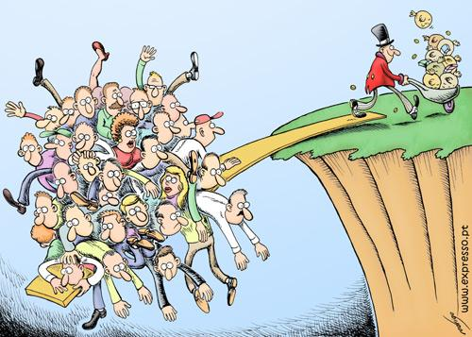
JUSTICE
John Rawls and others claim that many of the inequalities we experience are a result of a "natural lottery" or a "social lottery". One of the most controversial issues in modern health care is the question pertaining to "who has the right to health care?"

Slide 30
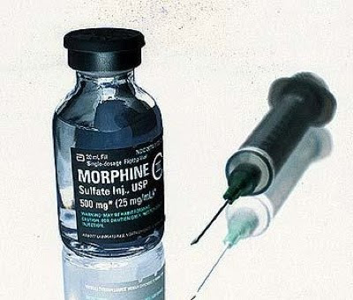
Double effect
Double effect is usually regarded as the combined effect of beneficence and non-maleficence.
MORPHINE
Beneficial effect - easing the pain and suffering of the patient,
Maleficent effect - hastening the death of the patient through suppression of the respiratory system.

Slide 31
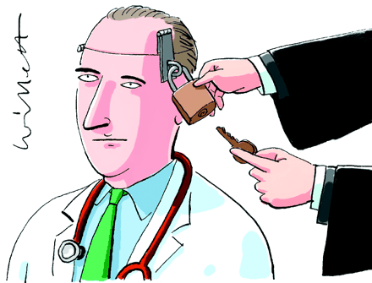
Confidentiality
Confidentiality is commonly applied to conversations between doctors and patients. This concept is commonly known as patient-physician privilege.
Legal protections prevent physicians from revealing their discussions with patients, even under oath in court.

Slide 32
Ethical Theories
Ethical theories are based on the previously explained ethical principles.
People usually base their individual choice of ethical theory upon their life experiences

Slide 33
Two approaches to ethical theory
Ethical theory in turn divides into two main
types or approaches:
virtue ethics: begins by considering what makes a person (or his/her character or motives) morally good (Aristotle, Hume)
duty ethics: focuses on rules or acts and what makes them right (Mill, Kant, Rawls)

Slide 34
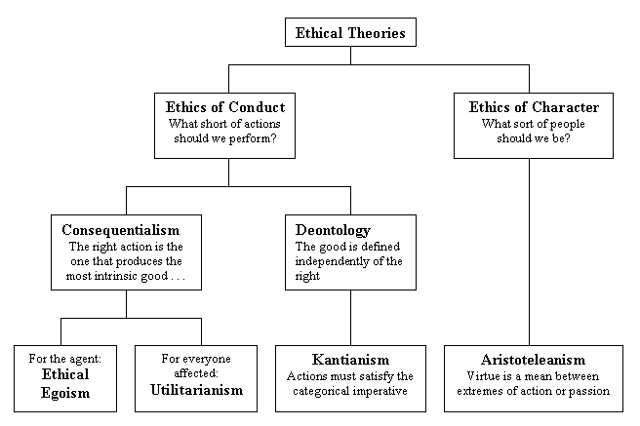

Slide 35
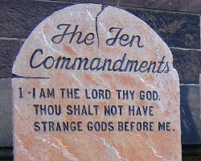
Deontological ethics
Deontological, or duty-based, ethical systems, are those that simply claim, what the fundamental ethical duties are.
The Ten Commandments - examples of deontological ethical thinking. The Ten Commandments say that some actions are just plain right and others are just plain wrong.

Slide 36
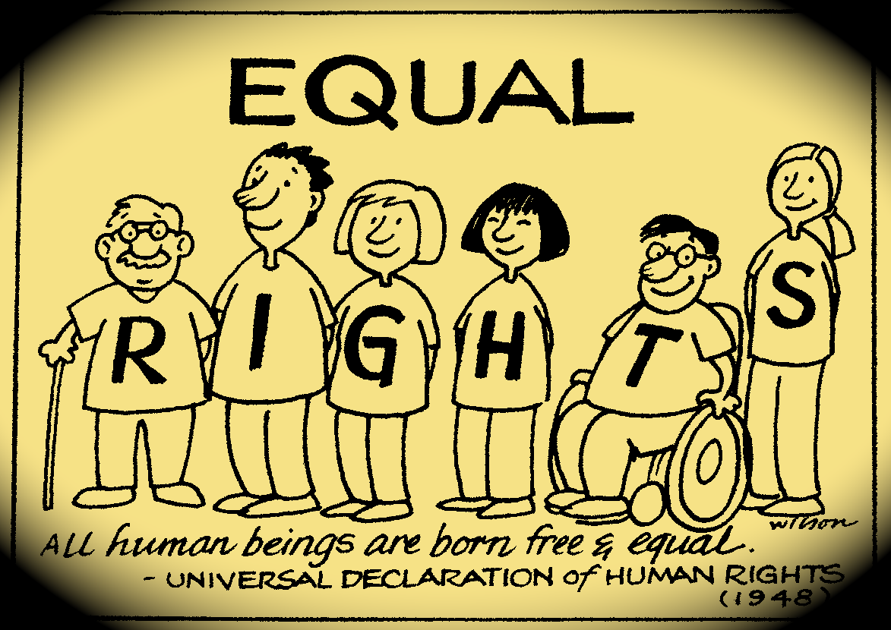
This is what characterizes deontological ethical methods: they simply state that some things are right or wrong. Some things are your duty to do (Greek deon: duty) and other things are your duty to avoid.
Human Rights documents, for example, are instances of deontological thinking.

Slide 37
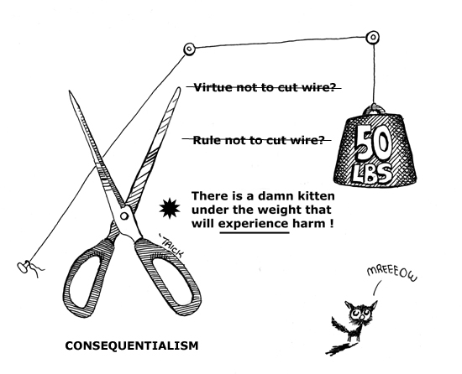
CONSEQUENTIALISM
Teleological methods, sometimes called consequentialist, are based on estimating what the likely outcomes of a given course of action will be, and then choosing the method that has the most positive consequences and the fewest negative consequences.

Slide 38
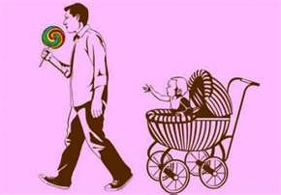
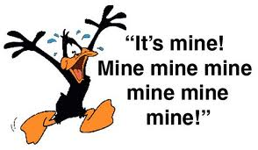
ETHICAL EGOISM
A moral theory that contends all choices either involve or should involve self-promotion as their sole objective.
Ethical egoists believe that people should not be their brother’s keeper, because people do not completely understand the true needs of others.
It’s every man for himself in this world!

Slide 39
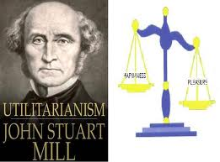
Utilitarian Theories
Moral theories that assert an action’s rightness is determined by the actual or probable consequences that the action will have for the greatest number of people affected by that action.
An action or practice is right if it leads to the best possible balance of good consequences over bad consequences for all the parties affected.

Slide 40
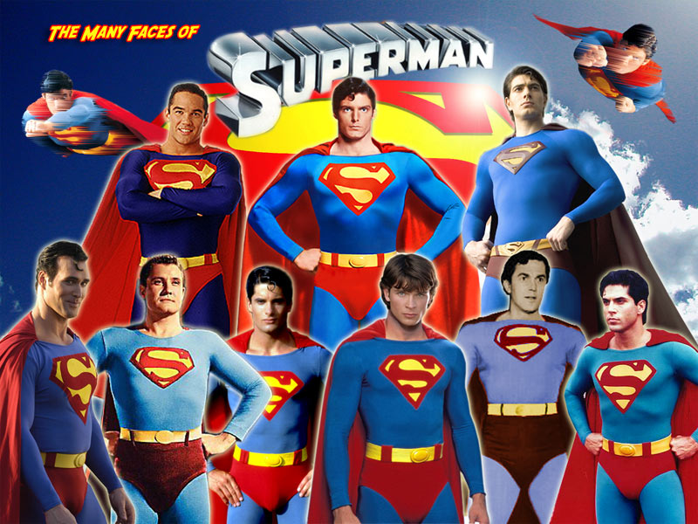
Utilitarian decision-
making relies on tools such as cost-benefit analysis and risk assessment to determine the greatest utility.
Example - Superman.

Slide 41
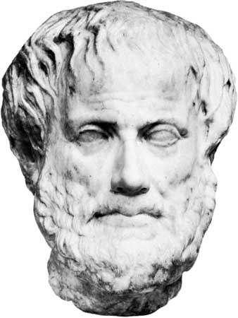
Aristotleanism
The ancient Greek philosopher Aristotle sought to describe what characteristics a virtuous person would have, and then argued that people should act in accordance with these characteristics.

Slide 42

Virtuous traits are acquired and developed throughout our life experiences.
A primary problem with this theory is that people have varying definitions of what traits are considered virtuous.
One weakness of this ethical theory is that it does not take into consideration a person's change in moral character.

Slide 43

Prima facie duties
When a person tries to decide how to act, each of these duties need to be taken into consideration when deciding which duty should be acted upon.

Slide 44
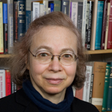
Frances Kamm
"Principle of Permissible Harm"
The Principle states that one may harm in order to save more if and only if the harm is an effect or an aspect of the greater good itself.

Slide 45
Case 2: Volleyball Player
Infection in her leg
60% Chance of recovery with antibiotics alone
80% Chance of recovery with antibiotics and amputation of the leg
Parents want doctors to amputate the leg, patient would like to only take antibiotics
Notes:
*

Slide 46
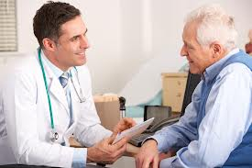
Physician-Patient Relationship.

Slide 47
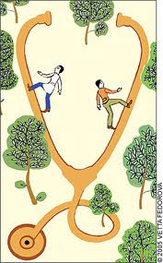
Ethical concerns over doctor-patient relationship
Autonomy and patient choice
Patient right Vs patient interest
Integrity of the medical profession
Shared decision-making in medical intervention

Slide 48
What constitutes a person’s autonomy?
Three aspects of autonomy
Freedom of thought
Freedom of will
Freedom of action

Slide 49
Conflicting Values
Paternalism:
  The doctor should act in a way that protects or advances the patient’s best interests, even if it is against the patient’s will.
Patient autonomy:
  The doctor should help the patient to make real choice, and provide intervention under the constraints of (a) informed consent and (b) confidentiality.

Slide 50
Difficult cases for doctors: some examples
Active and passive euthanasia
Right to refuse treatment
DNS (Do-not-resuscitate) order
Abortion
Experimental/risky interventions

Slide 51
Ethical models at a glance
  Paternalistic model
  Informative model
  Interpretive model
  Deliberative model

Slide 52
Paternalistic model
Principle
Assumptions
Sources
Problems
The doctor should make all the decisions for a patient.
People are not always rational/mature.
Experts know better about the needs of patients.
Qualified doctors have good will.
Hippocratic Oath; Plato.
Are the needs of patients objective? How can we be sure that doctors have good will?

Slide 53
Informative model
Principle
Assumptions
Problems
The doctor should provide all the relevant information for the patient to make a decision, and provide the selected intervention on this basis.
A fact/value division of labor yields the best medical result.
What is good for a patient depends on what his/her personal values.
Consumerism.
What if the patient is unconscious, incompetent, and making choices totally unacceptable by our ethical standards?

Slide 54
The interpretive model
The doctor should help the patient to articulate his/her values through interpretation, and provide intervention which is truly wanted.
Patients have unconscious and inconsistent desires.
Their conscious decisions may not reflect their deepest values.
All that a doctor can do is to help the patient see his/her own desires/values more clearly, but not to criticize them.
Principle
Assumptions
Limitation

Slide 55
The deliberative model
The doctor should help the patient to deliberate well through dialogue and discussion, and so develop values which are objective and truly worthy.
The objectivity of values.
The patient’s good life consists not in the satisfaction of desires, but maturity and rationality.
Is the model different from the paternalistic model? What is the difference between dialogue and persuasion?
Principle
Assumptions
Problems

Slide 56
Case 3: Pain relief in Hospice
86 year old man
Pancreatic Cancer
Hospice and Palliative Care
Refuses all pain medication
Staff and other patients are upset at “screams of agony”
Notes:
*

Slide 57

ETHICAL ISSUES IN MODERN MEDICINE.
Notes:
The term bioethical issue is a broad concept which involves a wide range of medical and biological processes that have been implemented in the field of medicine. While some issues, such as abortion and suicide, are widely criticized, others, such as human cloning and nanomedicine, have left the world divided.

Slide 58
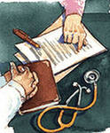
Advance Directives
A living will tells how you feel about care intended to sustain life. You can accept or refuse medical care. There are many issues to address, including
The use of dialysis and breathing machines
If you want to be resuscitated if breathing or heartbeat stops
Tube feeding
Organ or tissue donation

Slide 59
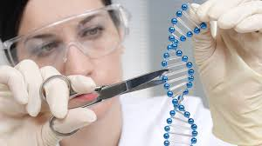
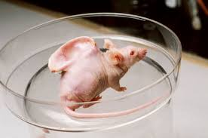
What is Genetic Engineering?
Scientific alterations in human possibilities
  Gene Therapy
  Stem cell research
  Human cloning
Scientific alterations in animal and plant life
  Modified grains tolerant of disease and drought
  Cloned animals

Slide 60
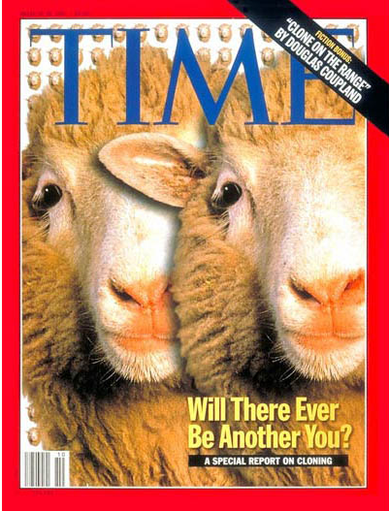
Cloning
The most famous clone was a Scottish sheep named Dolly.
There are three different types of cloning:
Gene cloning, which creates copies of genes or segments of DNA
Reproductive cloning, which creates copies of whole animals
Therapeutic cloning, which creates embryonic stem cells. Researchers hope to use these cells to grow healthy tissue to replace injured or diseased tissues in the human body.

Slide 61

Why clone humans?
Creating replacement tissue (spare parts)
Producing a fully developed human being for infertile couples
Reproducing outstanding humans in history

Slide 62

Moral and Legal Issues of Cloning
Do people have a right to reproduce by any available means?
Do other societal concerns override any such rights?
Will there be harmful effects on the cloned twin?
How will family relationships be redefined?
Could persons be cloned without their consent?
Would cloning be immoral because it is “unnatural”?

Slide 63

Genetic Testing
Genetic tests are tests on blood and other tissue to find genetic disorders. About 900 such tests are available. Doctors use genetic tests for several reasons. These include:
Finding possible genetic diseases in unborn babies
Finding out if people carry a gene for a disease and might pass it on to their children
Screening embryos for disease
Testing for genetic diseases in adults before they cause symptoms
Confirming a diagnosis in a person who has disease symptoms

Slide 64

Current IVF embryo policy
What is an IVF clinic?
  Place where a couple can go after difficulty conceiving a child
  Woman’s eggs extracted; man contributes sperm
  Woman’s egg fertilized in-vitro
    Outside her body
    Embryos inserted into her uterus → pregnancy

Slide 65

Current IVF embryo policy
Left-over embryos
  IVF procedure generates many embryos to increase chances of success
  Usually get thrown out or frozen
  BUT, stem cells can be derived from these!

Slide 66

Current IVF embryo policy
Which is ethically “better”?
    Throwing out an extra embryo, OR
    Saving the embryo for adoption, OR
    Using the embryo for biomedical research?
How do we find a compromise?

Slide 67




What diseases do we do stem cell research on first?
Muscular dystrophy
likely to die by age 20
VS.
Spinal cord injuries
  paralyzed, but likely to live longer

Slide 68



What diseases do we do stem cell research on first?
  Spinal cord injuries
  Alzheimer’s disease
  Type II (adult) diabetes
  Multiple sclerosis
  Type I (juvenile) diabetes
  Heart disease
  Cancer
  Parkinson’s disease
  Mental illness

Slide 69

Complementary and Alternative Medicine

Slide 70

Organ Donation
Organ donation takes healthy organs and tissues from one person for transplantation into another. Experts say that the organs from one donor can save or help as many as 50 people. Organs you can donate include
Internal organs: Kidneys, heart, liver, pancreas, intestines, lungs
Skin
Bone and bone marrow
Cornea
Most organ and tissue donations occur after the donor has died. But some organs and tissues can be donated while the donor is alive.
People of all ages and background can be organ donors.

Slide 71

Abortion
Whether or not it is moral, should abortion be legal?
Generally prohibited but with some exceptions?
Should it be regulated?
Is it a free choice to seek abortion in desperation because of poverty, violence, or lack of support?
What should be the community and policy response to women who feel unable to give birth to their children?
And what is the role of the father in decisions about abortion?

Slide 72
Thank you for your attention!

