Slide 1
Ukrainian state in the conditions of communist totalitarianism.
Western Ukrainian lands in the interwar period (20-30th years of the ХХ century).
Ukraine during the Second World War (1939-1945).
Plan
Ukraine –the part of Union of Soviet Socialist Republics (USSR)
Industrialization and Collectivization in Ukraine
The Second world war (1939-1945) in Ukraine
The results of the Second world war

Slide 2
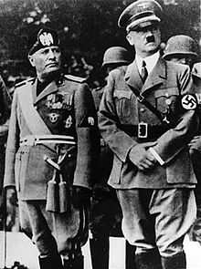
Totalitarianism
“Closed and immovable socio-political structure where every process – from upbringing children to the manufacture and distribution of consumer goods are regulated and controlled from one center”
Latin word “totalis” – universal, general

Slide 3
Totalitarianism
Benito Mussolini: “As more complicated becomes state as more the freedom of person has been limited”
Features of Totalit. state:
  Government totally controlling all spheres of life and every man personally
  State looks like machine were people are little and not important details which can be changed every moment if necessary”

Slide 4
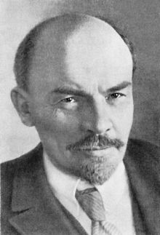
Bolsheviks (“the majority”)
The Bolsheviks came to power in Russia during the October Revolution phase of the Russian Revolution of 1917
under the direction of Vladimir Ilyich Lenin

Slide 5
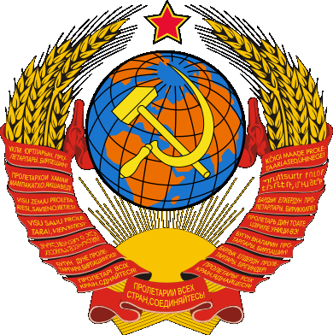
Union of Soviet Socialist Republics (USSR)
a single-party state ruled by the Communist Party
In December 1922 the Bolsheviks won the Civil war, and the Soviet Union was formed

Slide 6
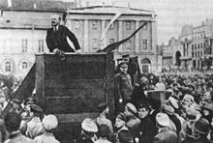
Vladimir Lenin addressing a crowd in 1920

Slide 7
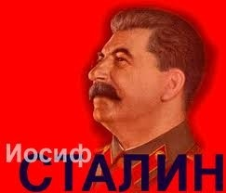
Joseph Vissarionovich Stalin - held the position of General Secretary of the Communist Party of the Soviet Union's Central Committee from 1922 until his death in 1953

Slide 8
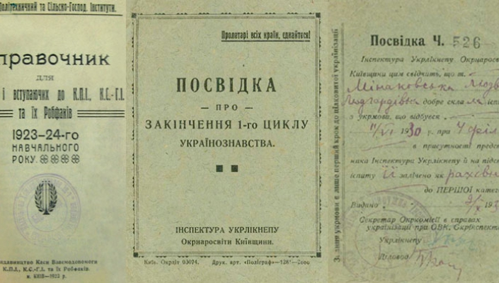
Ukrainianization policy
The Communist Party sought to gain support among the population of Ukraine, and especially among the intelligentsia. To this end, the policy of Ukrainization was carried out. It included the following activities:
- formation of leading cadres from the local population;
- legislate the use of the native language in all government bodies and in all institutions;
- development of national press, theater, etc .;
- Office work in the national language.
April 1923 - the proclamation by XII of the RCP (b) of the course on indigenization.
The indigenization is the permission to the peoples of the USSR to develop their culture, language, education.

Slide 9
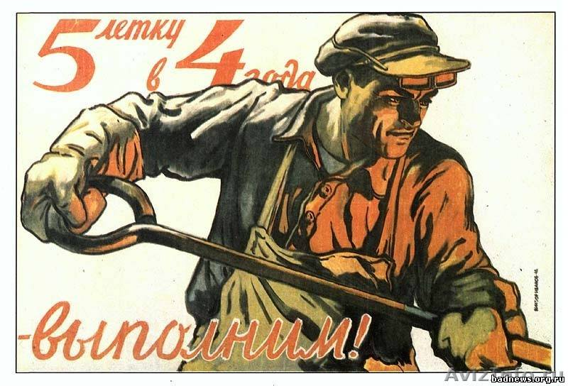
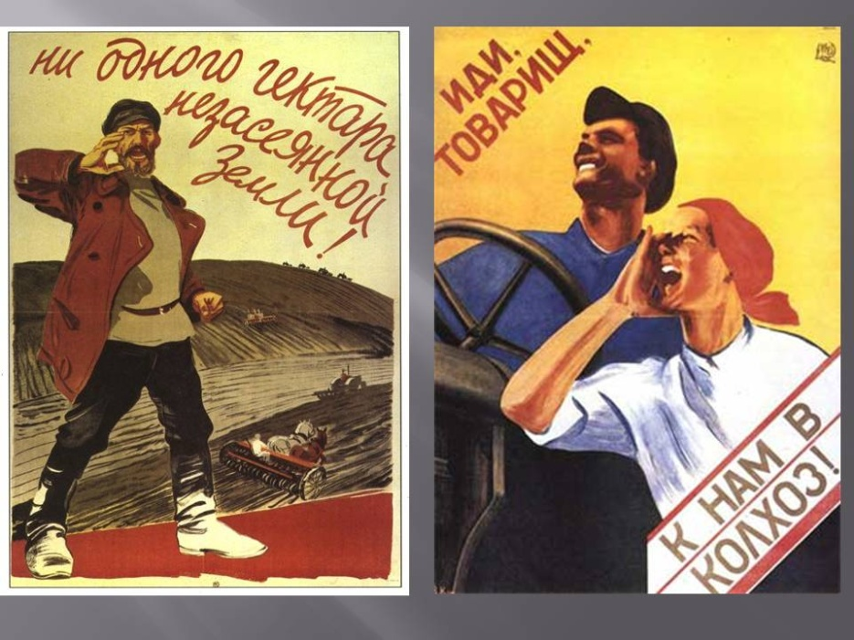
Two big programs of how to change the society
INDUSTRIALIZATION
COLLECTIVIZATION

Slide 10
INDUSTRIALIZATION
(economy)
All plants and factories were nationalized – government became the one owner of all industry (it was proclaimed that all people are the masters of industry)
Private property was prohibited and abolished
Maine role played heavy industry, mostly – military manufacture (because totalitarian state firstly is a military state)

Slide 11
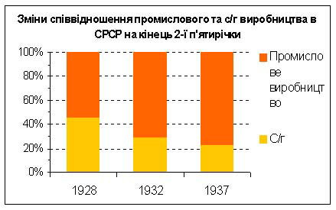
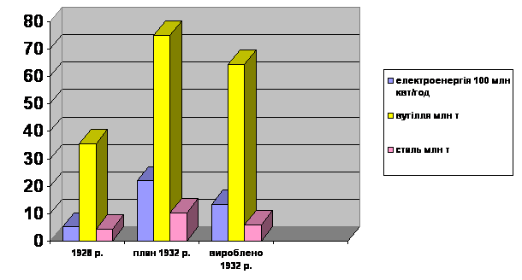
Результаты индустриализации:
Results of industrialization
- the country from agrarian became industrial-agrarian;
- strengthened defense capability of the country;
- unemployment was eliminated, but the standard of living of the population decreased (inflation, the rationing system, shortage of goods);
- monopoly of state ownership;
- a new model of economic management was created - an administrative-command system.

Slide 12
COLLECTIVIZATION
(the agroindustrial complex)
Private property was also destructed
Lands which was taken from its owners were putting at the sphere of collectivization (unions were made)
So all territories belong to everyone and nobody at the same time
Peasants had to give their cattle, agricultural equipment in to common use

Slide 13
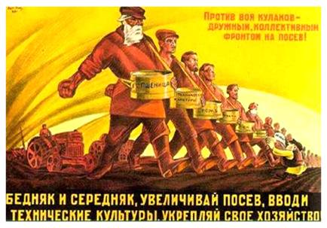
Agitation to join collective farms (kolkhoz)

Slide 14
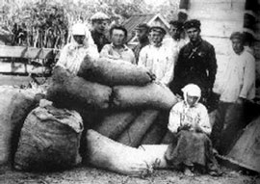

Slide 15
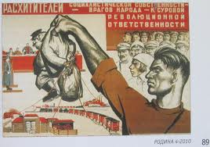

Slide 16
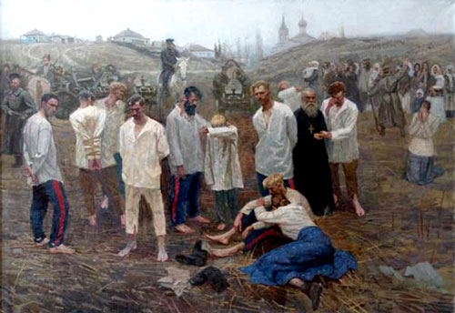

Slide 17
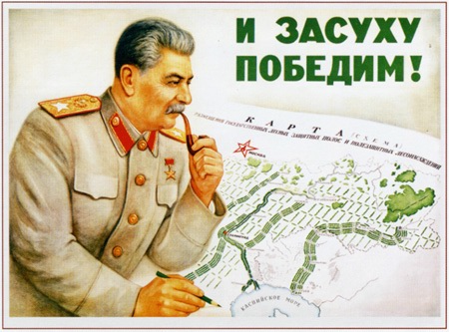
Starvation
1921-1922
reasons:
Natural – drought
Political:
  To clean the territory from indignant, not satisfied by Bolsheviks` power, peasants
Stalin: We will be victorious over drought

Slide 18
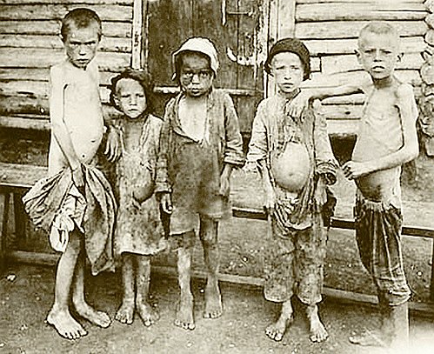
Only in 1921-1922 1-2 million of lives was taken by starvation

Slide 19
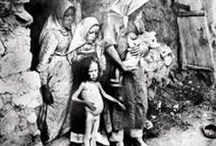

Slide 20
Collectivization
Officially, the course for complete collectivization - the Plenum of the Central Committee of the CPSU (b) in November 1929
January 5, 1930 - Resolution of the Central Committee of the CPSU (b) on the pace of collectivization in Ukraine: completion in the autumn of 1931, or in the spring of 1932
By the end of 1932 in Ukraine about 70% of peasant farms, owning 80% of the sown area, were merged into collective farms.
Collectivization became the main cause of the Holodomor of 1932-1933.

Slide 21
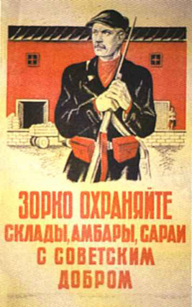
Причины Голодомора 1932-1933 гг.
Causes of the Holodomor 1932-1933
solid forced collectivization;
Unable for the peasants grain stores;
Forcible removal of hlib and food supplies from the peasants;
Excessive grain exports;
Mass terror against the peasantry;
The destruction of the peasantry as a conscious social stratum that could resist the communist government

Slide 22
Hunger, famine has become a tool of coercion. Hunger suppressed the resistance of the peasants, broke his will and forced the peasants to go to work in collective farms.
In 1930, collectivization caused mass protests and uprisings. During the year, more than four thousand mass protests took place in Ukraine involving up to 1.2 million. peasants.
During the first seven months of 1932, Ukraine accounted for 56% of all anti-power actions in the Soviet Union.

Slide 23
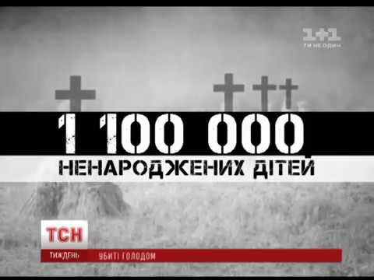
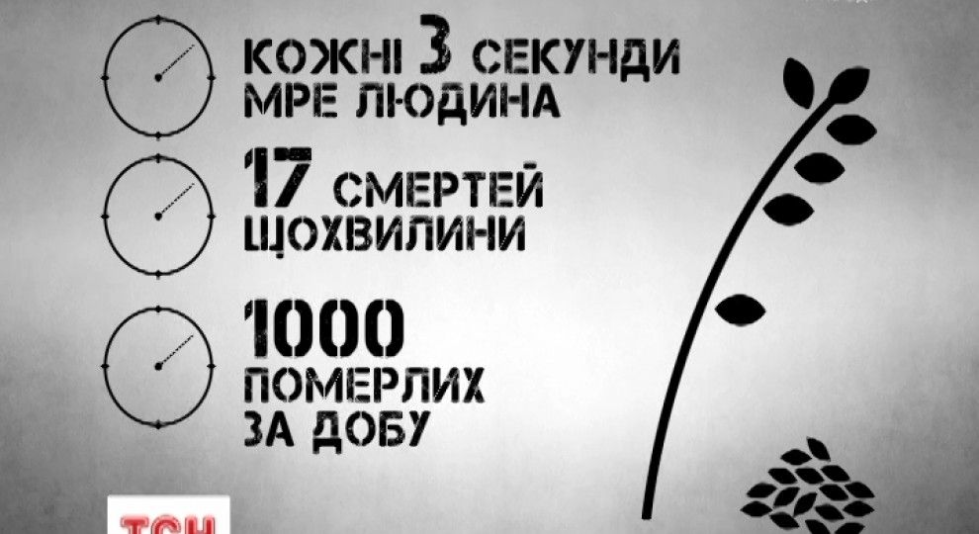
Famine 1932-1933 - This is the genocide of the Ukrainian people.
Demographic losses of Ukraine due to the famine of 1932-1933.
By 1989, materials about the Holodomor were state secret
Modern demographers say about 3-4 million people died of starvation (about 10% of those killed are city dwellers !!!).
These are the only victims that have been accurately identified.

Slide 24
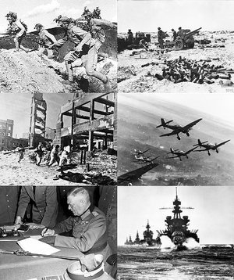
SECOND WORLD WAR
1 September 1939 –
2 September 1945
(6 years, 1 day)

Slide 25
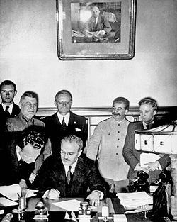
Molotov–Ribbentrop Pact
23 August 1939
named after the Soviet foreign minister V. Molotov and the German foreign minister J. von Ribbentrop, was an agreement officially titled the Treaty of Non-Aggression between Germany and the Soviet Union

Slide 26
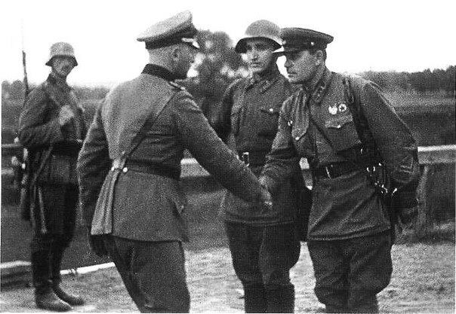
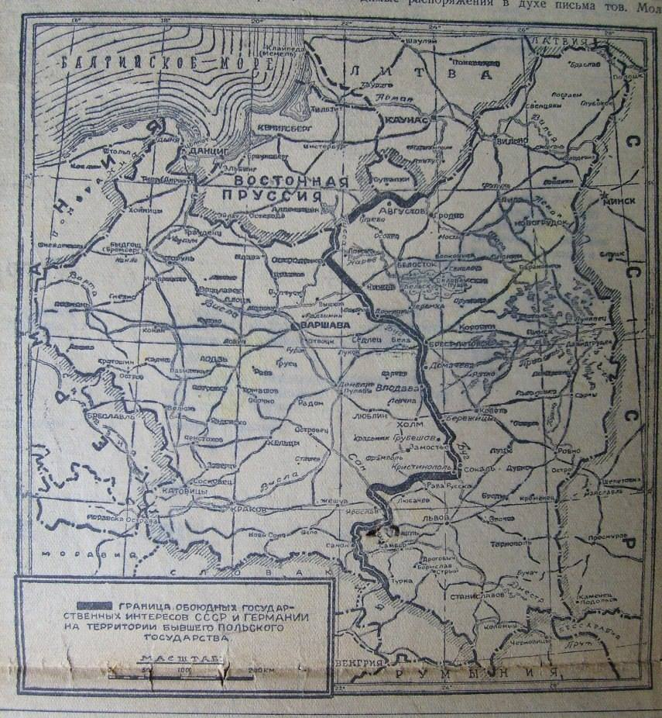
The start of the war - 1 September 1939, German invasion of Poland;
Britain and France declared war on Germany two days later
At the first stage of the Second World War, the Soviet Union helped Germany to destroy Poland. In fact, the USSR was an ally of Nazi Germany in 1939-1941.

Slide 27
On June 22, 1941 Germany and its allied powers invaded the Soviet Union.
Red Army suffered great losses and the soldiers often found themselves surrounded
By the end of September, the Red Army left Odessa, and in the middle of October the battles were expanded near Kharkiv and Donbas

Slide 28
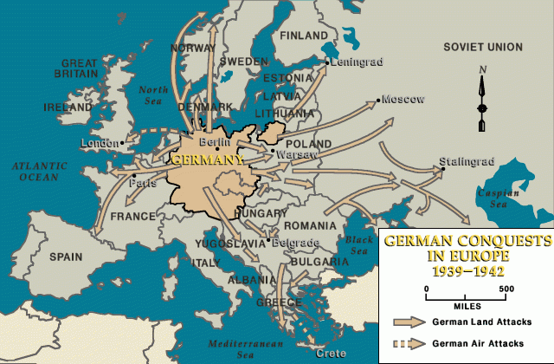
June 22, 1941 Germany attacked the USSR.
Concentrated in the mobile group "North" - Leningrad,
"Center" - Moscow and
"South" - Ukraine, Kiev, and on Stalingrad.
The German armies were moving fast.
They tried to implement the Blitzkrieg plan. The defeat of the USSR from a few months to one year.

Slide 29
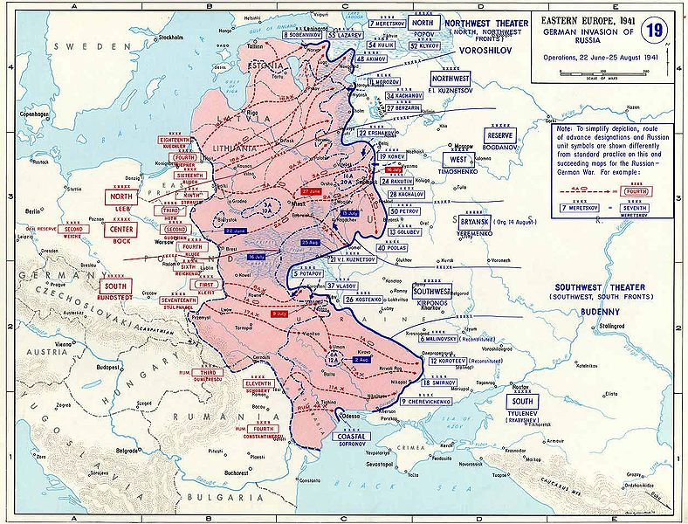

Slide 30
The retreat of the Red Army was accompanied by the use of "scorched earth" tactics
Destroy everything that the enemy can use against the USSR: equipment plants, machinery, grain, etc.
One of the terrible crimes of the Stalinist regime was the undermining by the NKVD forces of the dam Dneprges in August 1941. This resulted in the deaths of tens of thousands of Red Army soldiers and peaceful inhabitants who were nearby.

Slide 31
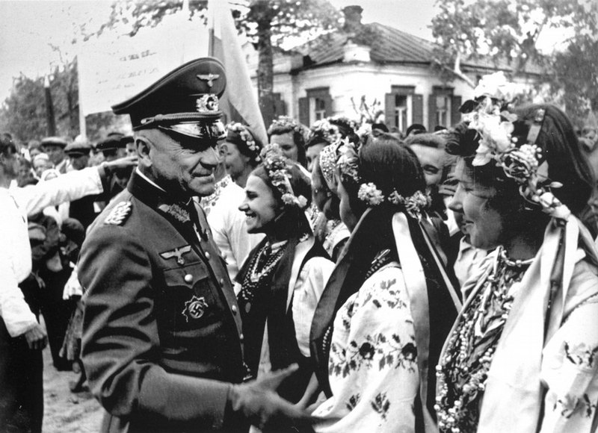
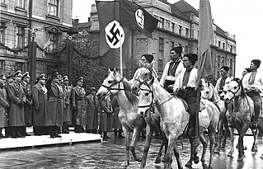
To the December,1 1941 main part of Ukrainian lands were occupied by nazi army.
July 22, 1942, after the capture of the Germans in the city of Sverdlovsk in the Voroshilovgrad oblast, the whole territory of the Ukrainian SSR was finally occupied.

Slide 32
Nazi regime divided Ukraine in parts:
- Chernivtsi and Izmail, Odessa, part of the Vinnytsya and Nikolayev region, as part of Romania. Transnistria
- Western Ukrainian lands - Galicia district
- Chernigov, Sumy, Kharkiv regions and Donbass as front-line zones were directly subordinated to the German military command.
- Other Ukrainian lands were part of the Reichsmissariat "Ukraine" with the center in the city of Rivne. He divided into six districts. Reichscommissar of Ukraine was appointed E. Koh
- Zakarpattia Ukraine since 1939 was occupied by Hungary.

Slide 33
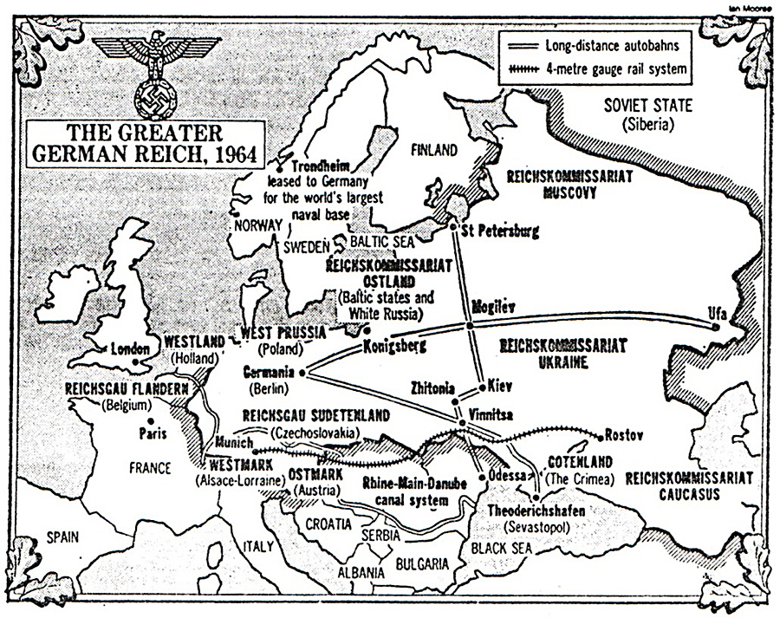
In the aggressive plans of the Nazis, Ukraine occupied a special place. The German command has developed the "Ost" plan.

Slide 34
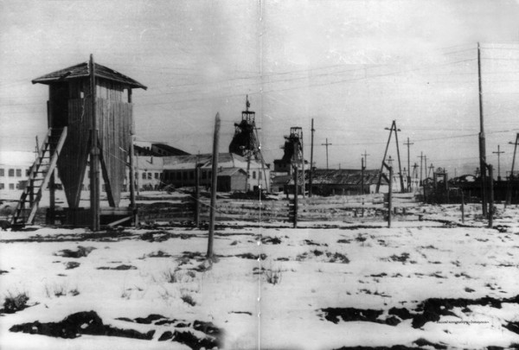
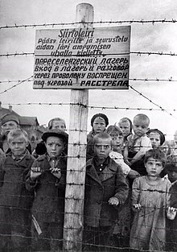
During the war, there were 180 concentration camps on the territory of Ukraine, where the occupants destroyed million prisoners of war and civilians.

Slide 35
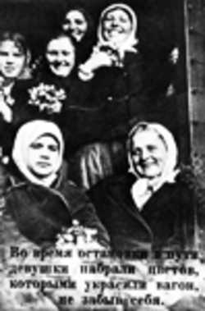
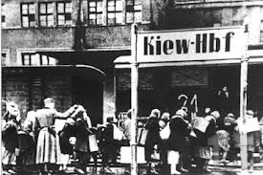
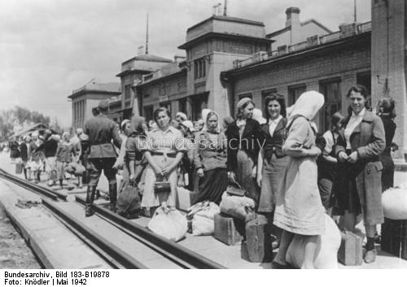
Ost-Arbeiters
In the occupied territories, the Nazis launched a propaganda campaign, calling for able-bodied people to work before the Reich. Ost-Arbeiters (workers from East) from Ukraine were used in hard work (2-3 million people, mostly young people). A significant number of workers died from unbearable working conditions.

Slide 36
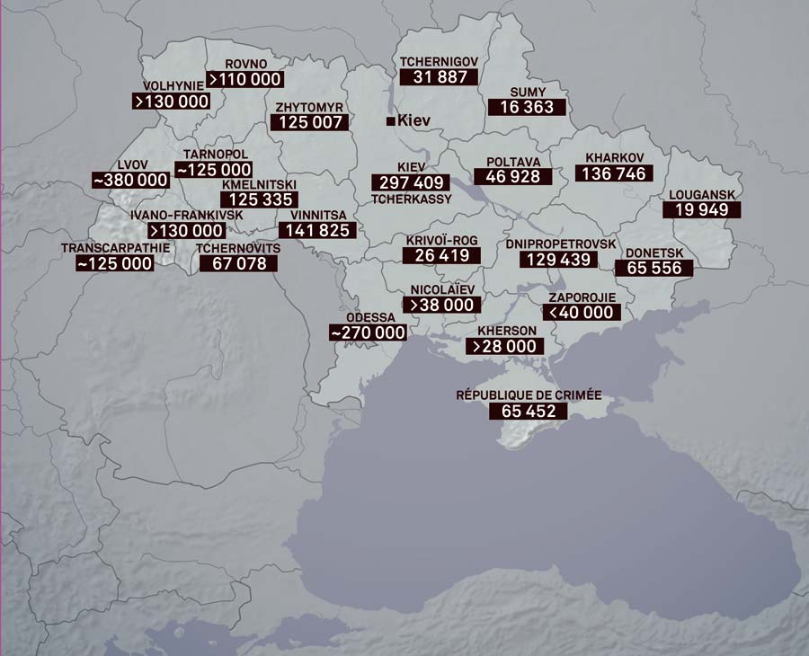
The Holocaust in Ukraine is the systematic extermination of Jews in Ukrainian territories occupied by Nazi Germany in 1941-1944.
For the period from 1941 to 1945, about 3 000 000 civilians died on Ukrainian lands, of which about 850 000 - 900 000 were Jews living in Ukraine.

Slide 37
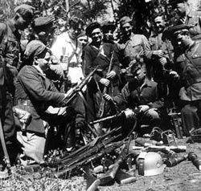
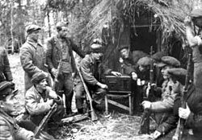
Resistance movement in the occupied territory of Ukraine.
Soviet partisans and underground. They were led from Moscow. Fought for the restoration of Soviet Ukraine.

Slide 38
Nationalist resistance movement. OUN-Ukrainian Insurgent Army (УПА) Fought for the independence of Ukraine
in Lviv, June 30, 1941 - S. Bandera and J. Stetsko (OUN-B) proclaimed the “Act of restoring the Ukrainian state.” But the German command arrested the initiators, began repressions against OUN-B. Many were sent to concentration camps.
Then the OUN-B decided to fight for the restoration of the Ukrainian state, relying only on its own strength. She goes underground. They had to fight against the forces of Nazi Germany, and against the troops of the Soviet Union.

Slide 39
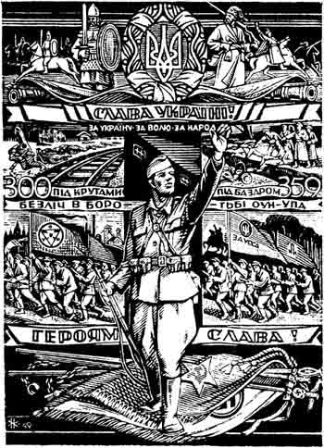
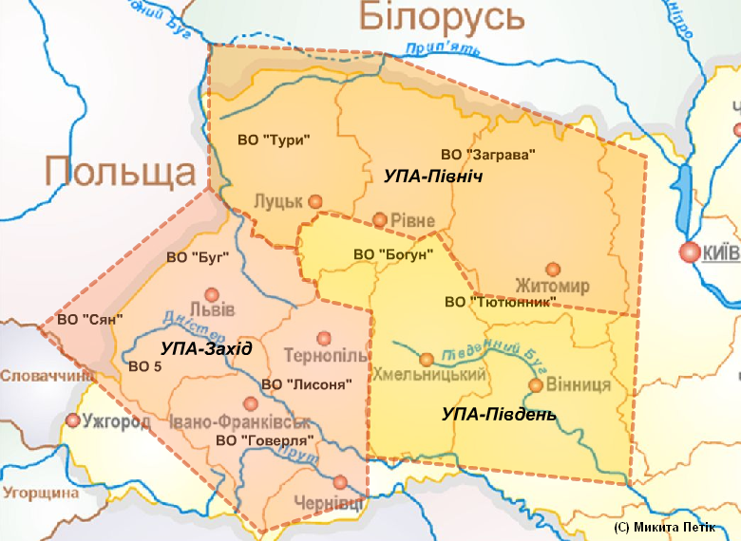
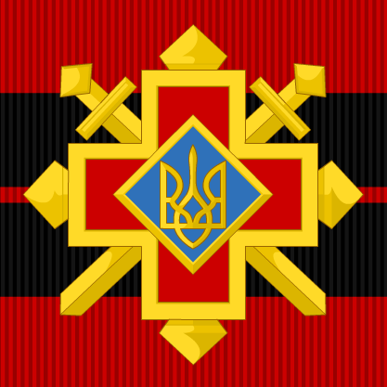
In 1942, the Ukrainian Insurgent Army - UPA was formed. its commander in chief was a member of the OUN (b) wire Roman Shukhevich. Guerrilla army controlled part of the territory of Volyn, Polesia and Galicia. In its composition, it consisted of about 30-40 thousand. Fighters. The Congress of the OUN (b) proclaimed its goal in the struggle against Bolshevism and Nazism.

Slide 40
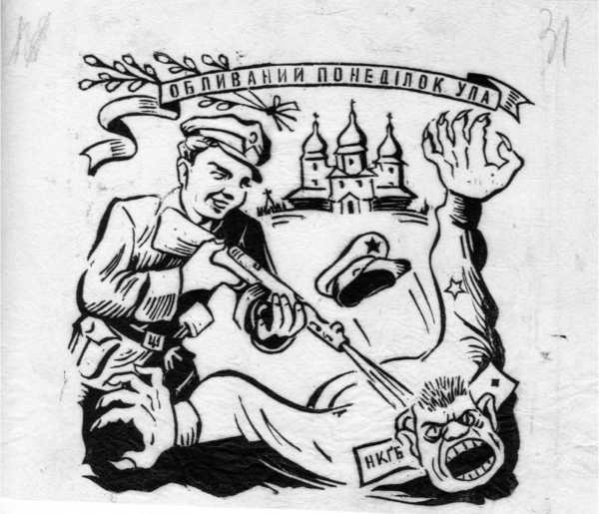
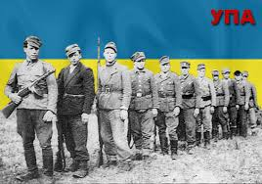
14 oct. 1942 – UPA
The resistance movement in Ukraine during the Second World War led the fight for the restoration of the Ukrainian SSR, and for the creation of a Ukrainian independent state. The Soviet and nationalist resistance movements brought the time of victory closer. However, they remained in different political positions, so the Soviet partisans and the UPA were in a state of open war and could not unite to fight the common enemy.

Slide 41
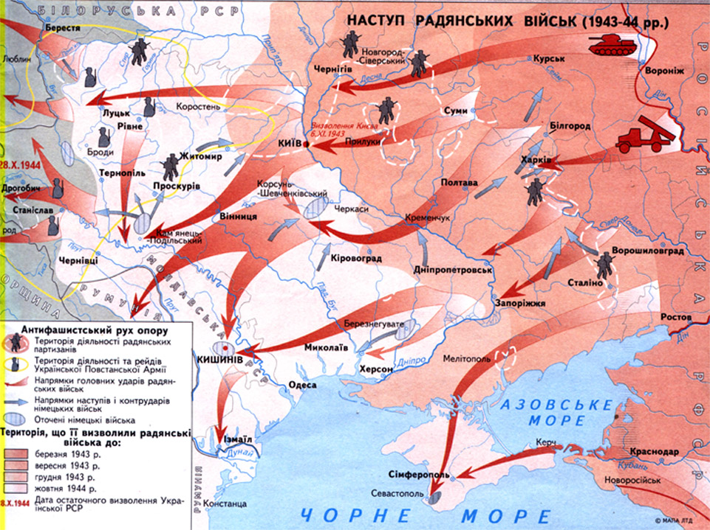
  The liberation of the territory of Ukraine. Completion of the Second World War.

Slide 42
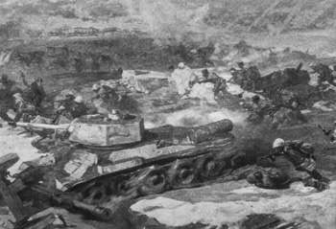
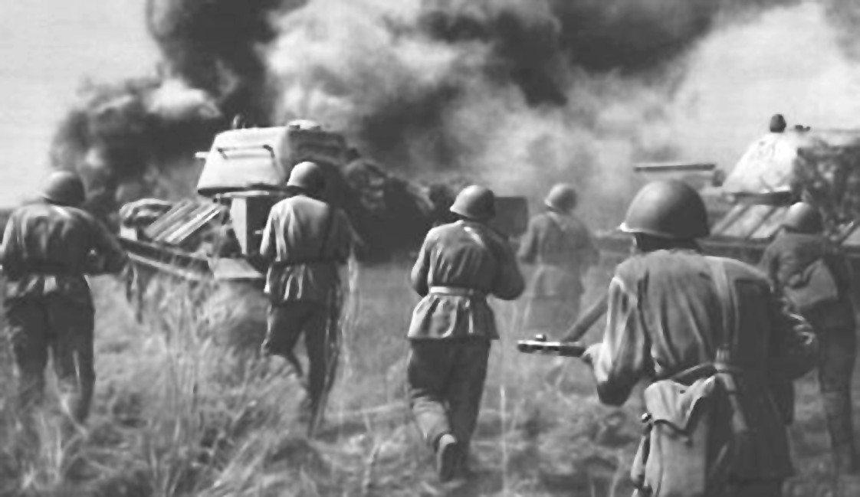
Since November 1942 - turning point of the war. Stalingrad Battle. Soviet Army passed to the full-scale offensive and defeted nazi troops in this battle.
Battle of Kursk (July 5 - August 23, 1943) victory of the Red Army.
prerequisites for the offensive of the Red Army on all fronts and the liberation of Ukraine.
At the end of August 1943 began a rapid offensive in the direction of the Dnieper. Especially heavy fighting was fought near Kiev.
November 6, 1943 Kiev was released.

Slide 43
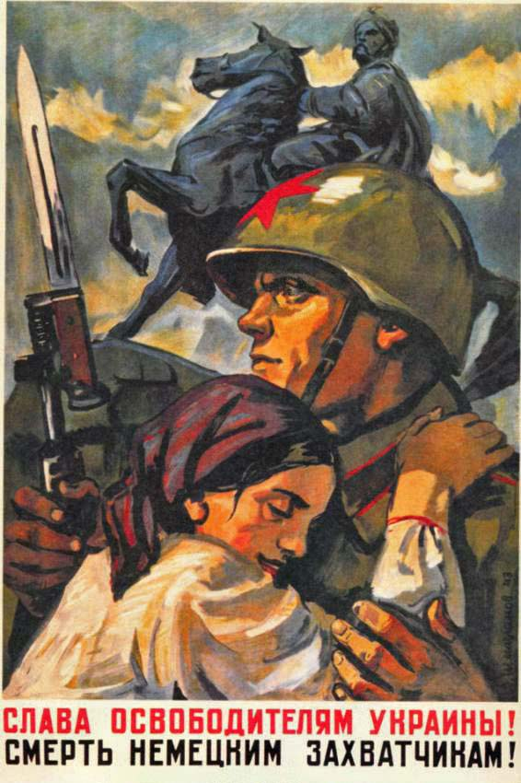
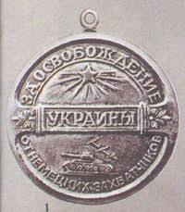
Liberation of Ukraine in the period of winter - spring 1944
Zhytomyr-Berdichev operation.
Korsun-Shevchenko operation.
Rovno-Lutsk operation.
Nikopol-Krivoy Rog operation.
Proskurov-Chernivtsi operation.
Uman-Botosha operation.
Odessa operation.
October 28, 1944 the territory of Ukraine was completely liberated from the German occupiers. The hostilities were
moved to the territory of Western Europe.

Slide 44
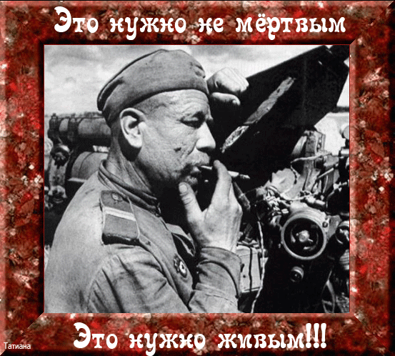
October, 14-15, 1943 – liberation Zaporozhe
In October 1944, the entire Ukrainian territory was free from enemy forces

Slide 45
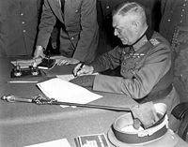
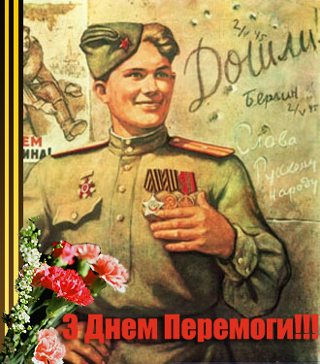
The Berlin operation, in which the troops of the 1st and 2nd Bielorussian and 1st Ukrainian fronts took part (total of 2.5 million people), became the last page in the war. On May 9, 1945, the statement of unconditional capitulation was signed in the presence of Soviet, American, English and French representatives.

Slide 46

USSR representative K. Derevianko signs the Japan Surrender Act
In summer 1945 The USSR entered the war with Japan. Together with the allies, Soviet troops fought against the Japanese Kwantung Army and defeated it.
September 2, 1945 - The end of the Second World War. The signing of the surrender of Japan.

Slide 47

World War II deaths

Slide 48
UKRAINE’S CONTRIBUTION TO VICTORY
Ukrainians made a major contribution to the victory over Nazism, becoming one of the victorious nations.
Millions of Ukrainians, with weapons in their hands, fought against Nazism during the war. Ukraine gave the Red Army: 7 Front and Army Commanders, 200 Generals, more than 6 million soldiers, NCO’s and officers.
About 120 thousand Ukrainians met the Nazis in September 1939 as part of the Polish Army. In subsequent years, more than 130 thousand Ukrainians fought in the armies of other anti-Hitler Allies (USA, British Empire, France). Hundreds of thousands of Ukrainians fought Nazism in the resistance movement.
As a result of the fighting, more than 700 cities and towns were destroyed in Ukraine along with tens of thousands of villages. Kyiv was 85% destroyed, Kharkiv – 70%, Dnipropetrovsk, Zaporizhzhia and Poltava suffered great devastation and Ternopilwas almost completely destroyed. Nearly 2 million homes were destroyed which resulted in more than 10 million homeless people. Overall, Ukraine’s material losses in the war were 285 billion rubles or $100 billion.

Slide 49


Soviet Flag over the Reichstag
American Flagat Iwo Jima
During the Soviet retreat of 1941, 550 industrial companies, property and livestock from thousands of farms was taken from Ukraine along with farms and dozens of academic and educational facilities, cultural centers and historical valuables. Nearly 3.5 million inhabitants left the republic – skilled workers and professionals, scholars, intellectuals who gave their labour and intellectual force in the development of the military and economic potential of the USSR.
In order to gain support in Ukraine, in 1943 Stalin was forced to make certain concessions to Ukrainians. The Ukrainian Fronts were created, the government of the Ukrainian Soviet Socialist Republic was formed on the basis of the People’s Commissars (Ministries) of Defence and Foreign Affairs.
In recognition of this Ukrainian contribution to the victory over Germany, Ukraine was included in one of the founding states of the United Nations

Slide 50


Slide 51
THANK YOU!
Thank you!
Spitsa N.V.
Didyk S.S.

